Slide 1
ONLINE MOVIE TICKET BOOKING SYSTEM
Group-6

Slide 2
TABLE OF CONTENTS
Introduction
Tools Required
Spring Cloud Config Server
Eureka Server
Feign Client
Resilience4J
Sleuth & Zipkin
DB Schema
Output Screenshots

Slide 3
TOOLS REQUIRED
Server-side: Spring Boot, Spring Cloud, Spring Data JPA
Database: MySQL
Server: EmbeddedTomcat
DevOps: Docker, Git Hub
Spring Cloud: Spring Cloud Config, Spring Cloud Netflix Eureka, Feign, Resilience4j, Retry, Sleuth and Zipkin

Slide 4
INTRODUCTION
In today's digital age, the demand for seamless movie booking experiences has never been higher.
Microservices - a game-changing approach to software architecture.
By breaking down our application into smaller, independent services, we unlock a world of possibilities.

Slide 5
Spring Cloud Config Server:
Imagine you have multiple microservices in your application, each with its own configuration settings like database connection details, feature toggles, or API endpoints. Keeping track of and managing these configurations can become complex, especially when you need to make changes across all services.
This is where Spring Cloud Config Server comes in. It acts as a central hub for storing and serving configurations to your microservices

Slide 6
Eureka Server:
Imagine you have many microservices in your application, each performing a specific task like user authentication, data processing, or serving web pages. These microservices need to find and communicate with each other. However, in a dynamic and scalable environment, knowing where each microservice is located can be challenging.
This is where Spring Cloud Netflix Eureka comes in. It acts as a service registry or a directory that keeps track of all your microservices

Slide 7
Feign Client:
Imagine you have a microservices-based application, and different microservices need to communicate with each other over HTTP to exchange data or perform actions. Manually writing the code to make these HTTP requests can be repetitive and error-prone, especially when you have multiple services to interact with.
This is where Feign Client comes in. It simplifies the process of making HTTP requests to other services by providing a more intuitive and declarative (annotations) way to define and call RESTful APIs

Slide 8
Resilience4j:
Imagine you have a microservices-based application where different services interact with each other and external services over the network. In such a complex and dynamic environment, failures, such as network issues or service unavailability, can happen unexpectedly. Ensuring that your application continues to function despite these failures is crucial.
This is where Resilience4j comes in. It provides a toolkit for building resilient applications by helping you manage and control the interactions between your services

Slide 9
Sleuth & Zipkin:
Imagine you have a complex microservices architecture with multiple services that communicate with each other to fulfill user requests. When a user interacts with your application, their request may bounce between several microservices before returning a response. If something goes wrong, such as slow response times or errors, it can be challenging to identify where the problem originated.
This is where Sleuth and Zipkin come to the rescue Sleuth (Distributed Tracing) Zipkin (Distributed Tracing Server)

Slide 10
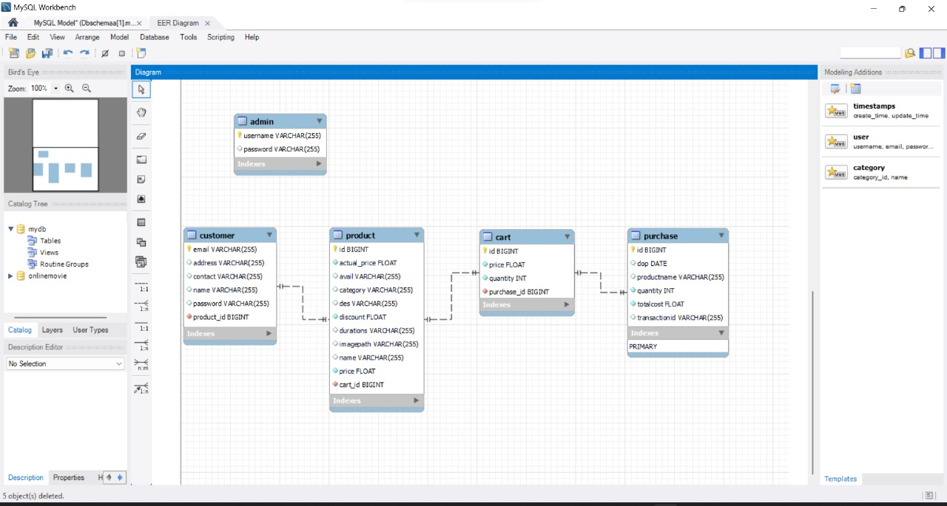
DB SCHEMA

Slide 11
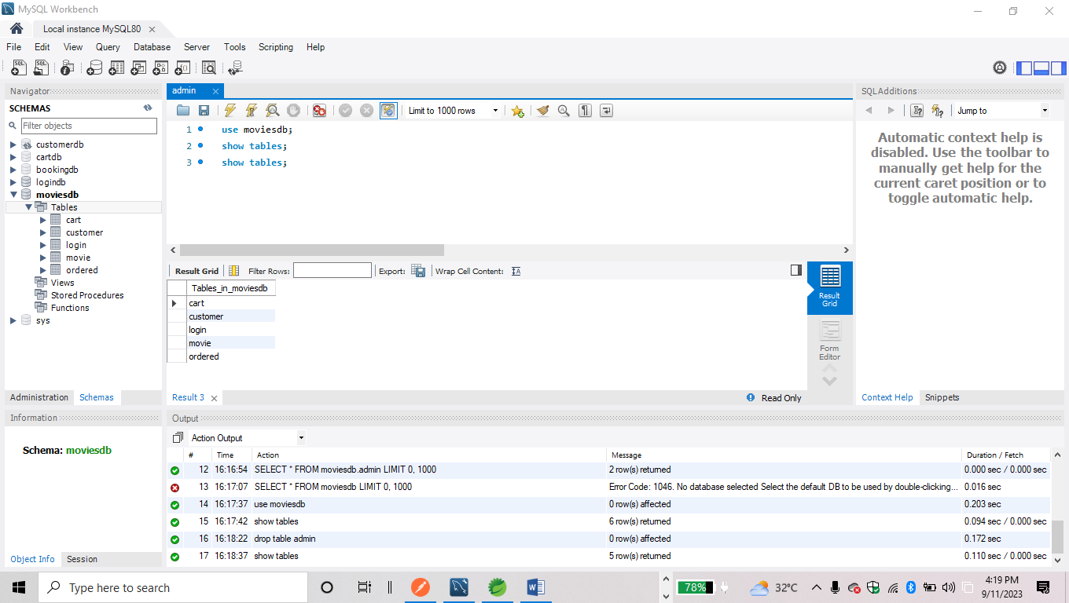

Slide 12
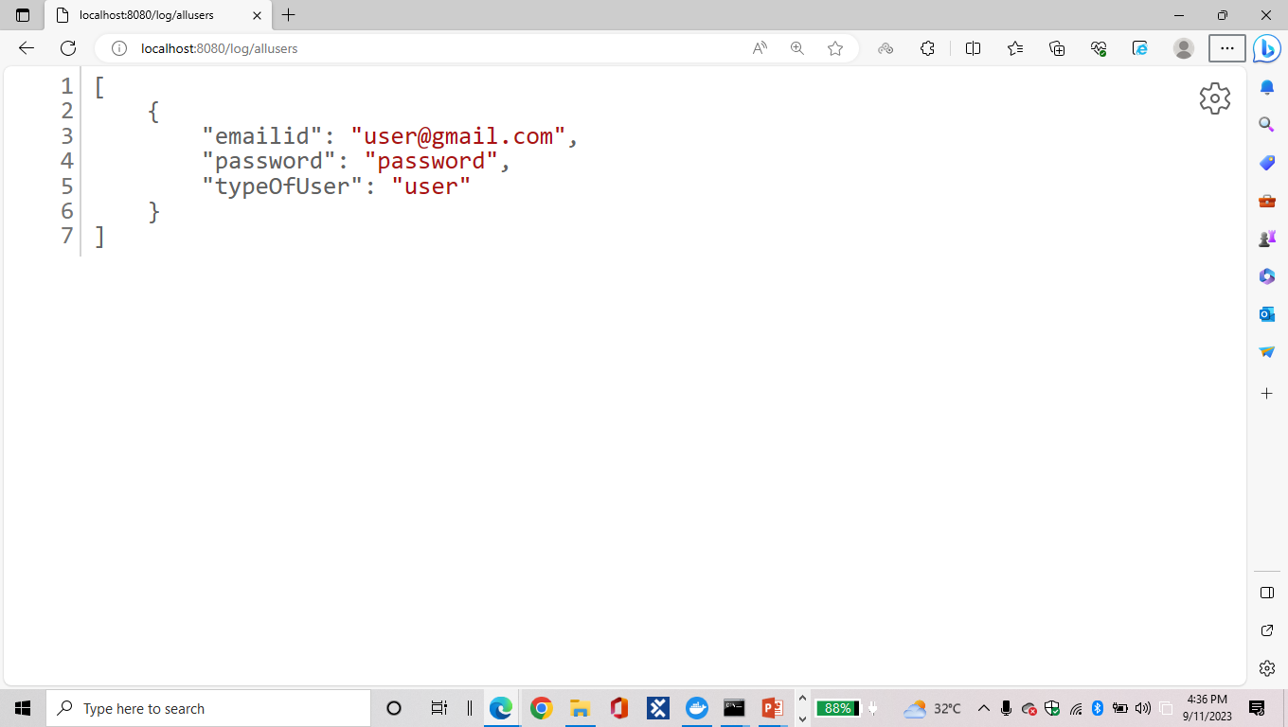
OUTPUT SCREENSHOTS
LOGIN SERVICE – MAIN APPLICATION:

Slide 13
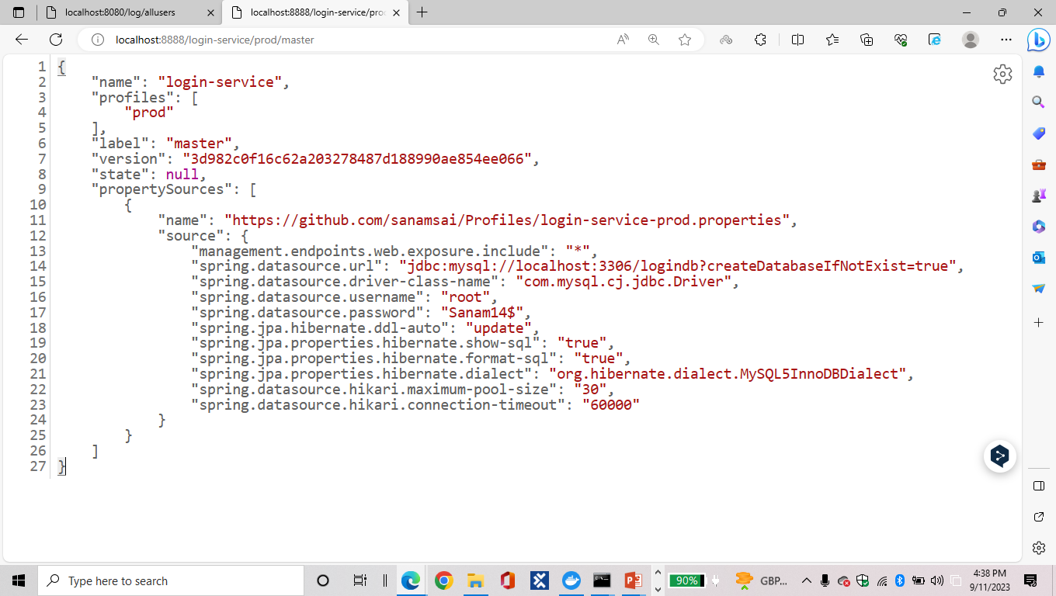
CONFIG SERVER FOR LOGIN SERVICE:

Slide 14
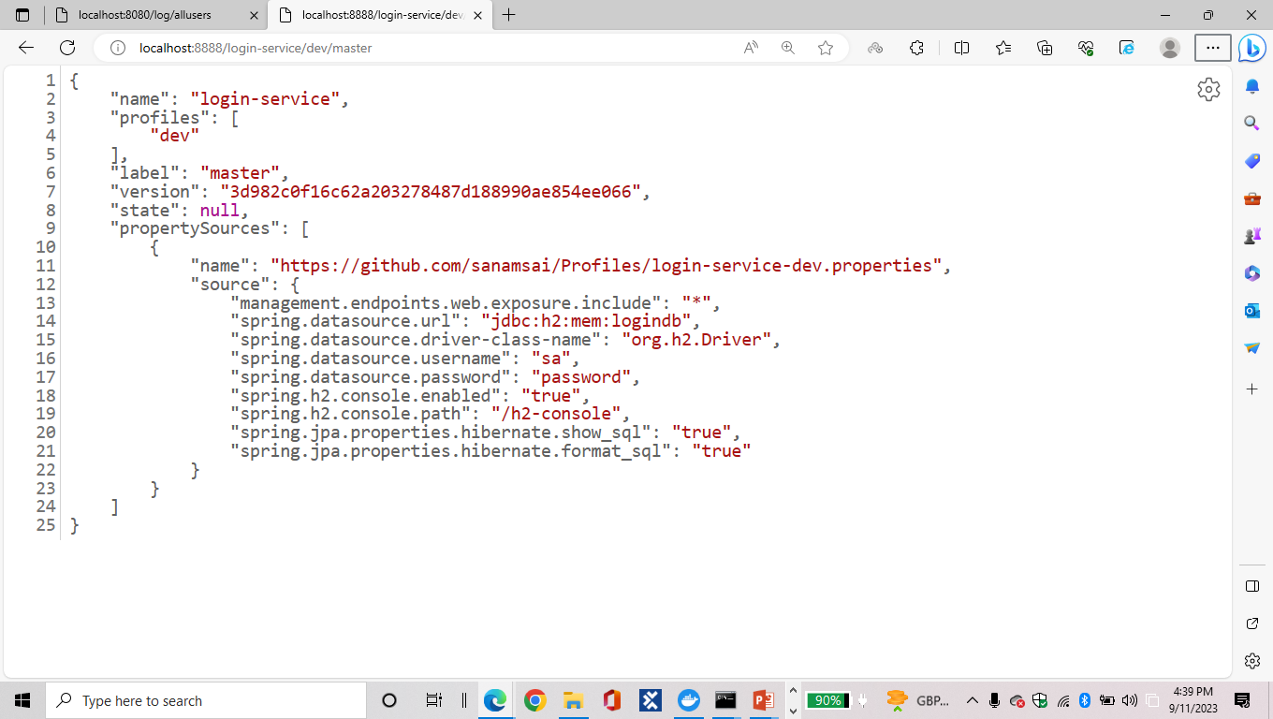
DEV PROFILE FOR LOGIN SERVICE:

Slide 15
PROD PROFILE FOR LOGIN SERVICE:

Slide 16
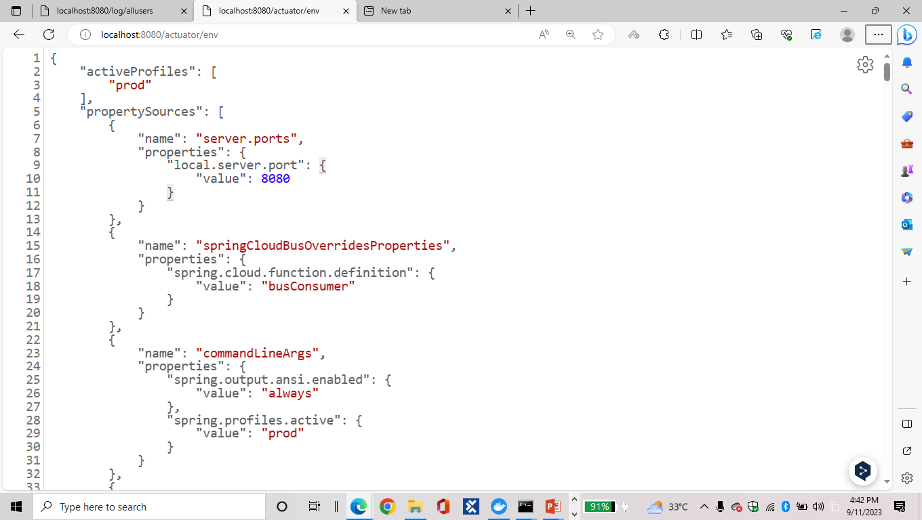
ACTUATOR ENV:

Slide 17
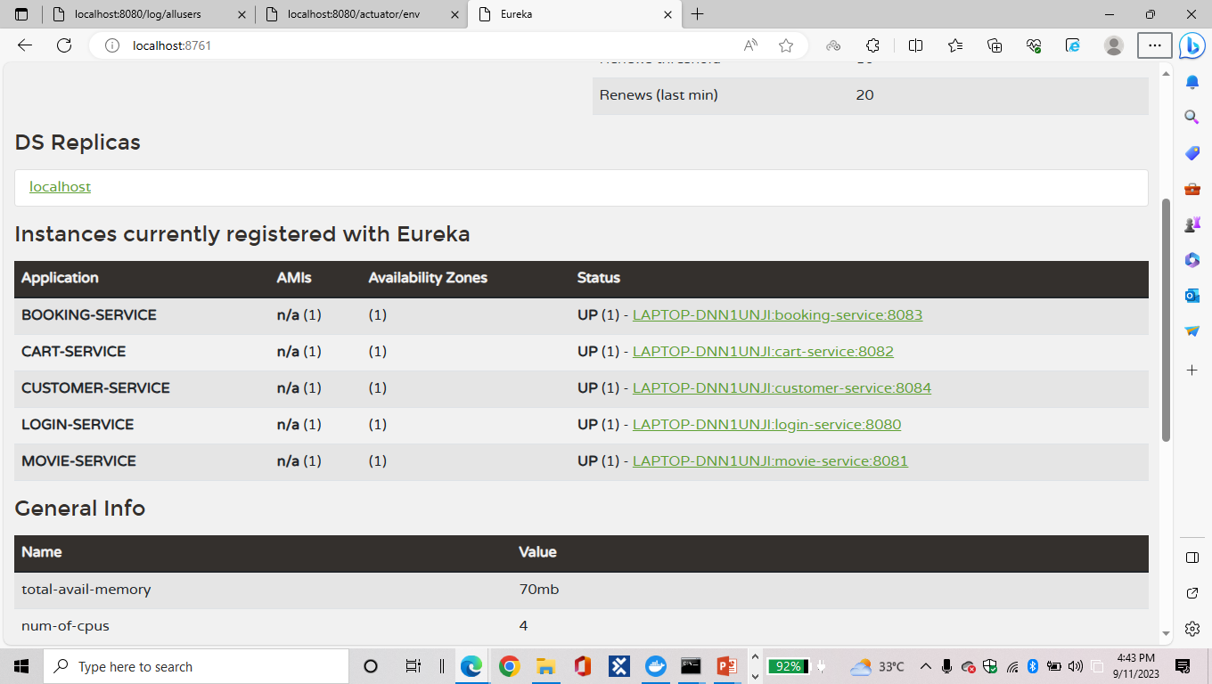
EUREKA FOR ALL SERVICES:

Slide 18
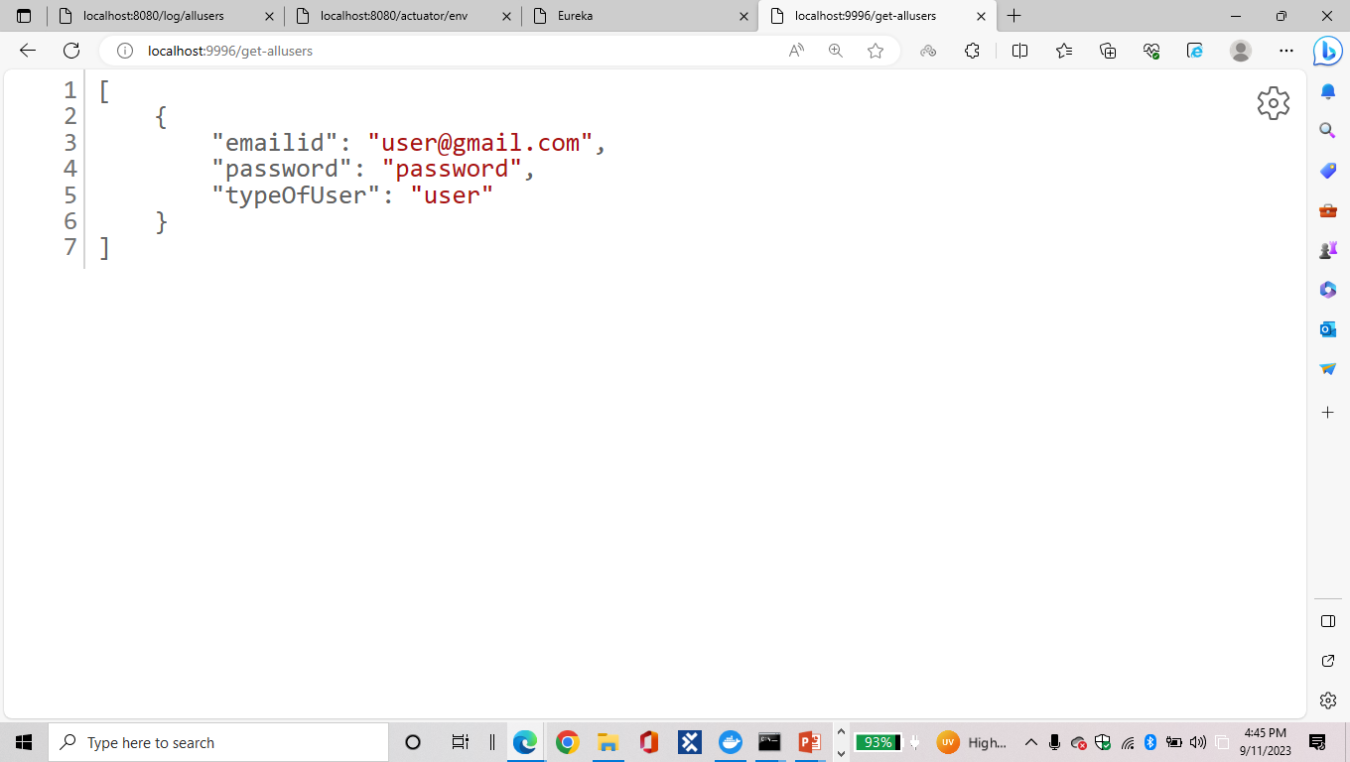
FEIGN FOR LOGIN SERVICE:

Slide 19
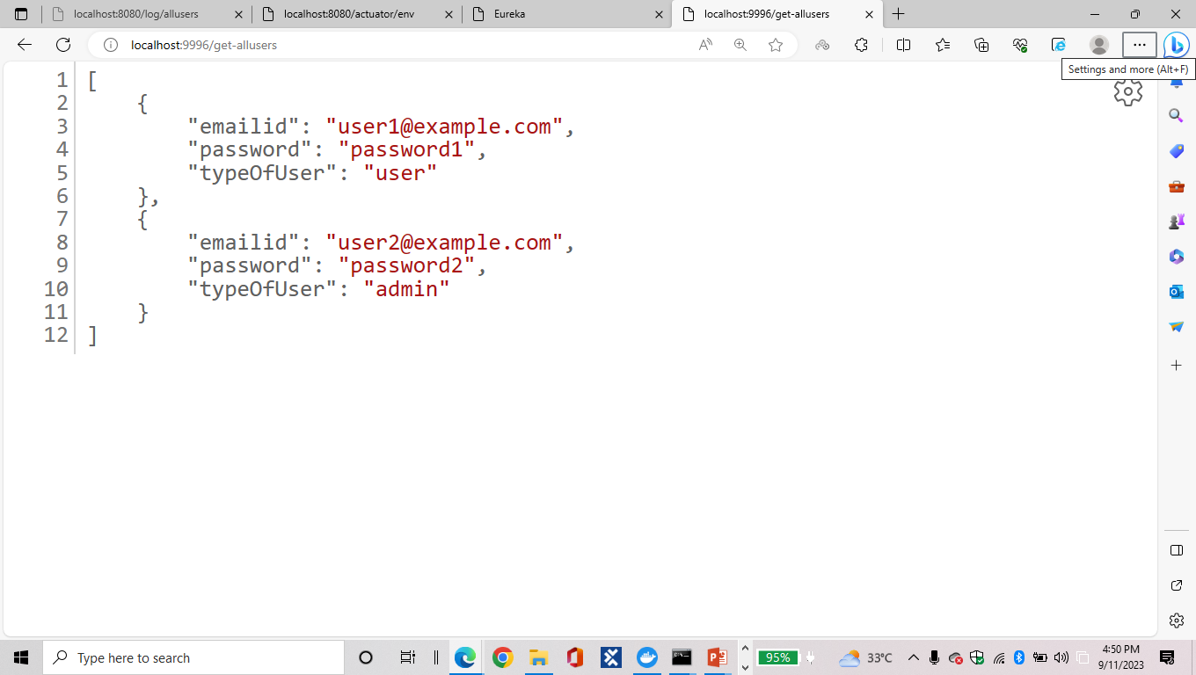
RESILIENCE FOR LOGIN SERVICE:

Slide 20
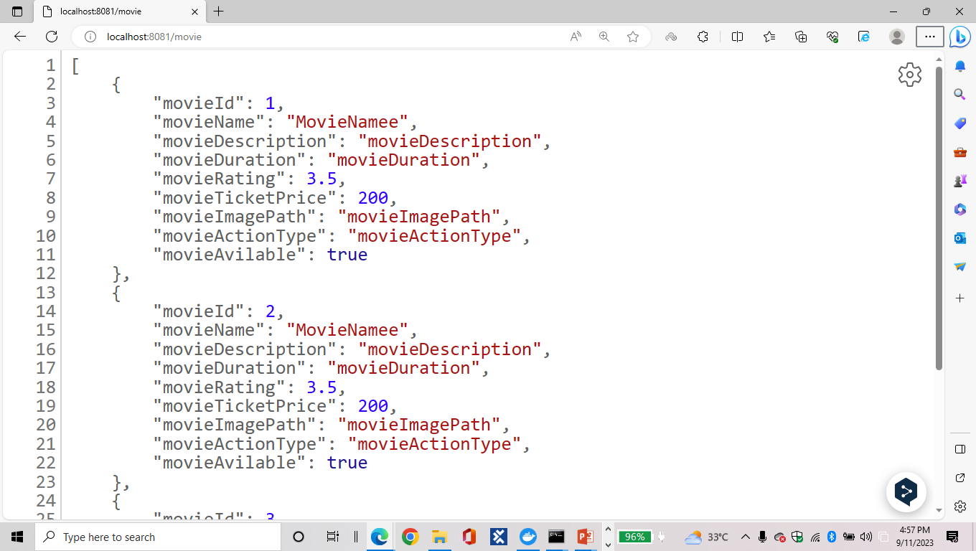
MOVIE SERVICE – MAIN APPLICATION:

Slide 21
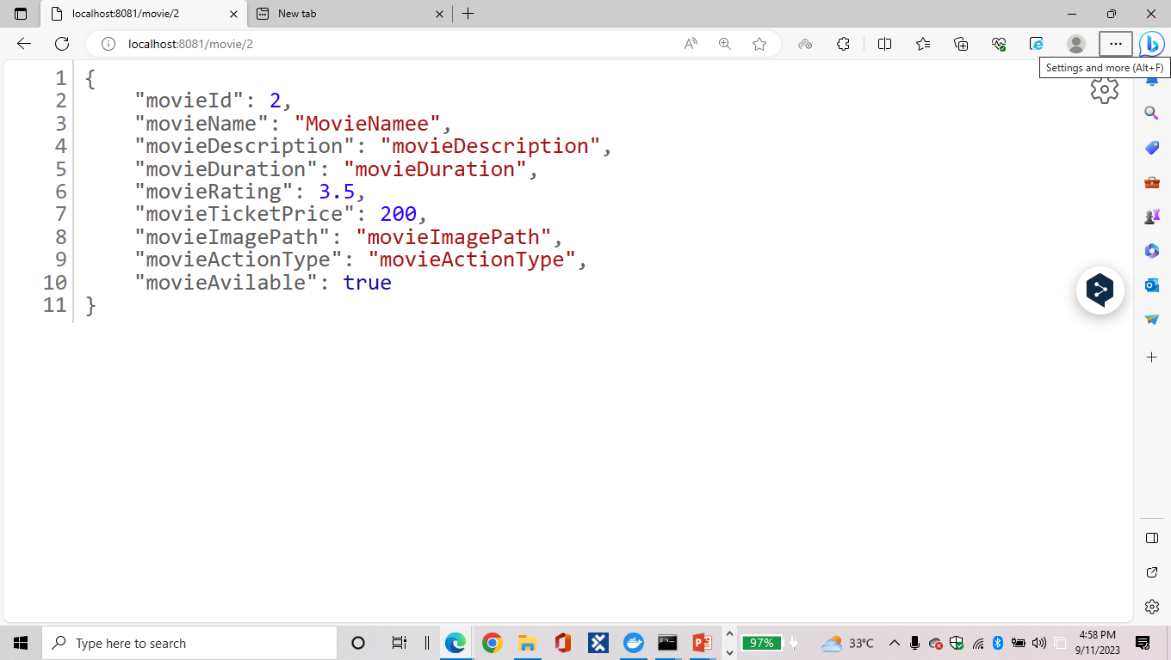

Slide 22
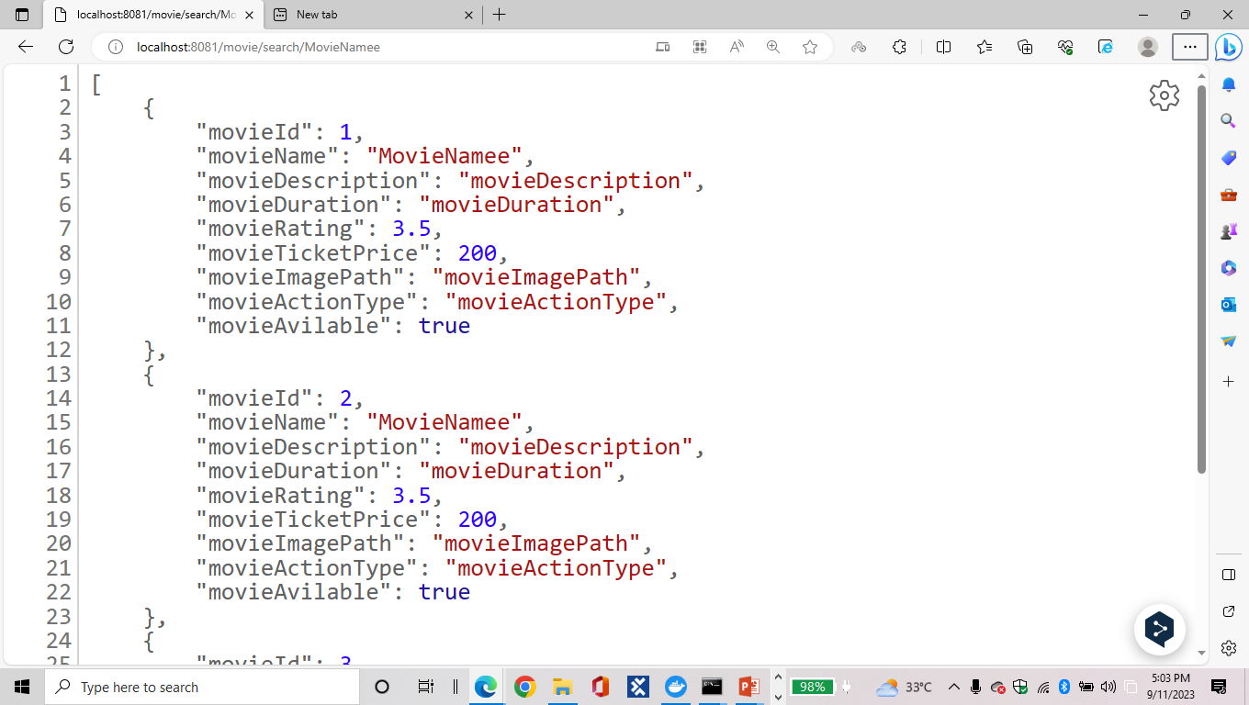

Slide 23


Slide 24

PROD PROFILE FOR MOVIE SERVICE:
CONFIG SERVER:

Slide 25
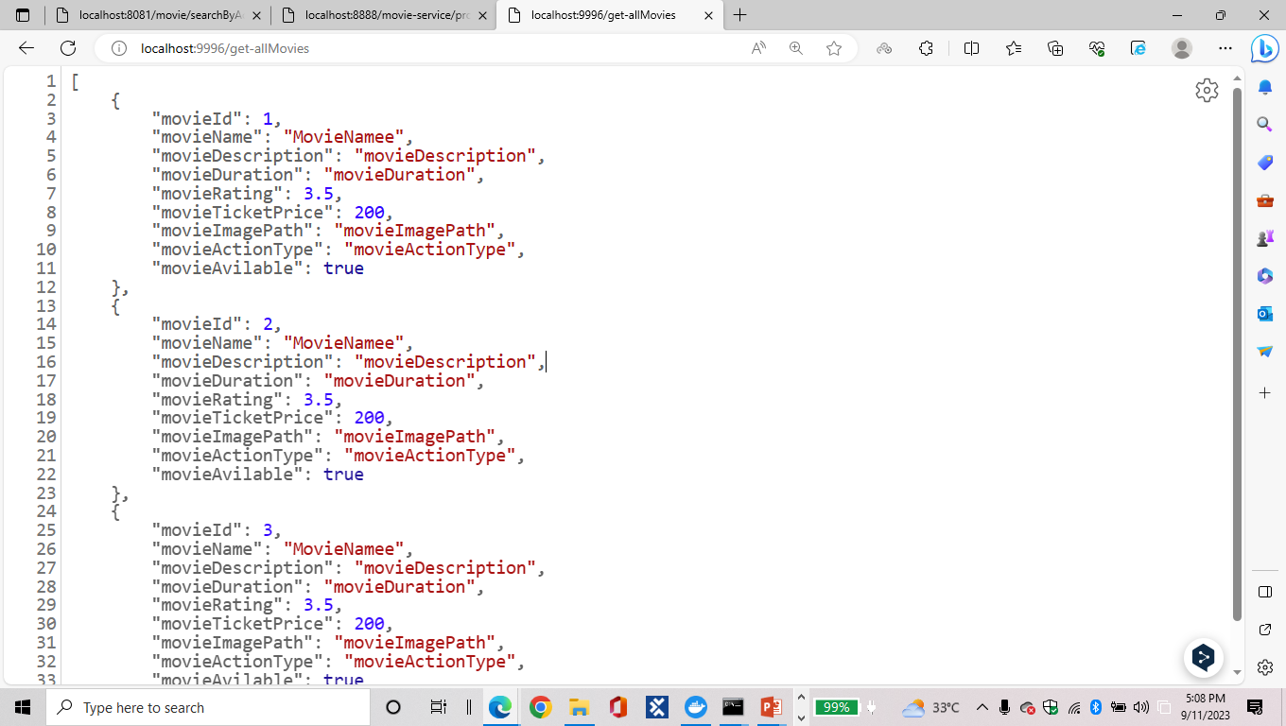
FEIGN FOR MOVIE SERVICE:

Slide 26
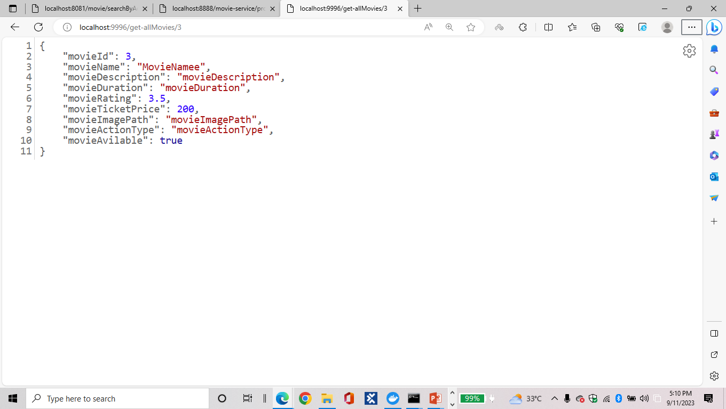

Slide 27
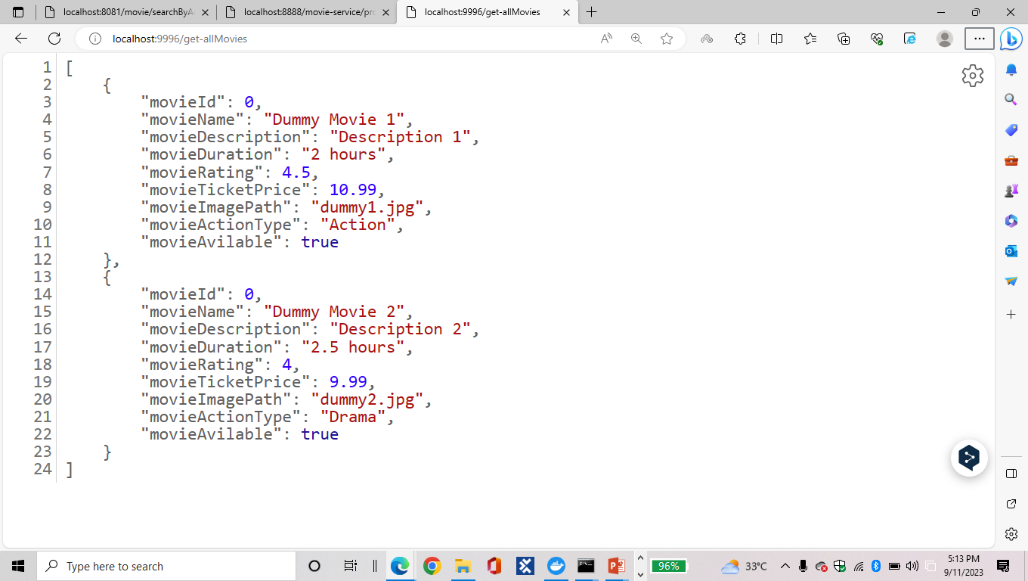
RESILIENCE FOR MOVIE SERVICE:

Slide 28
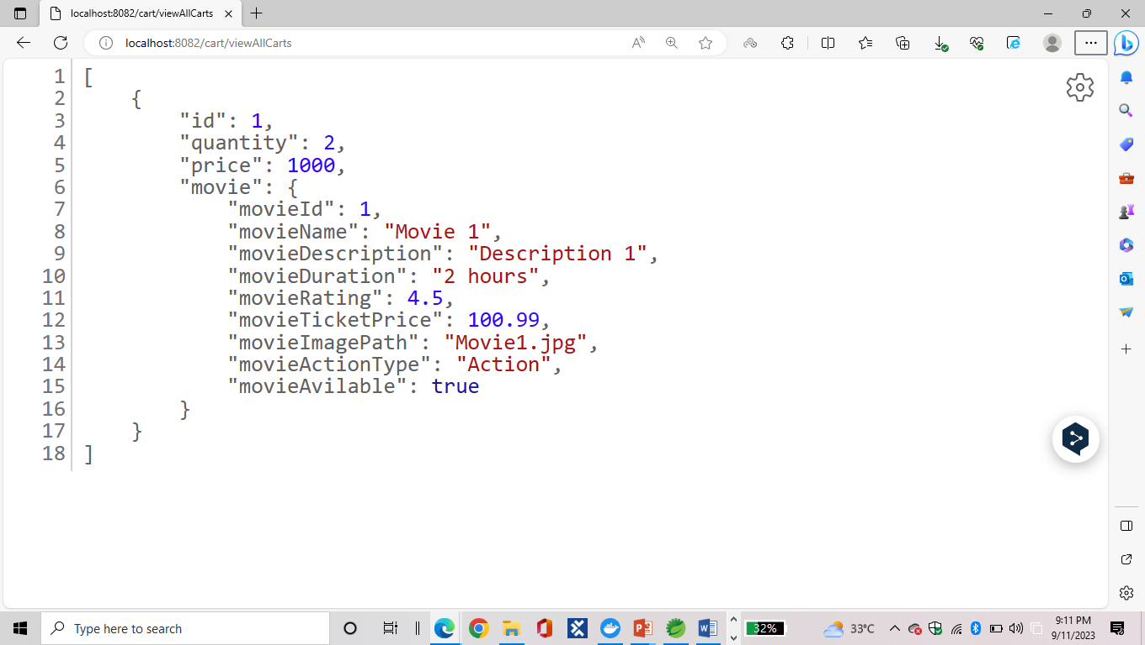
CART SERVICE – MAIN APPLICATION:

Slide 29
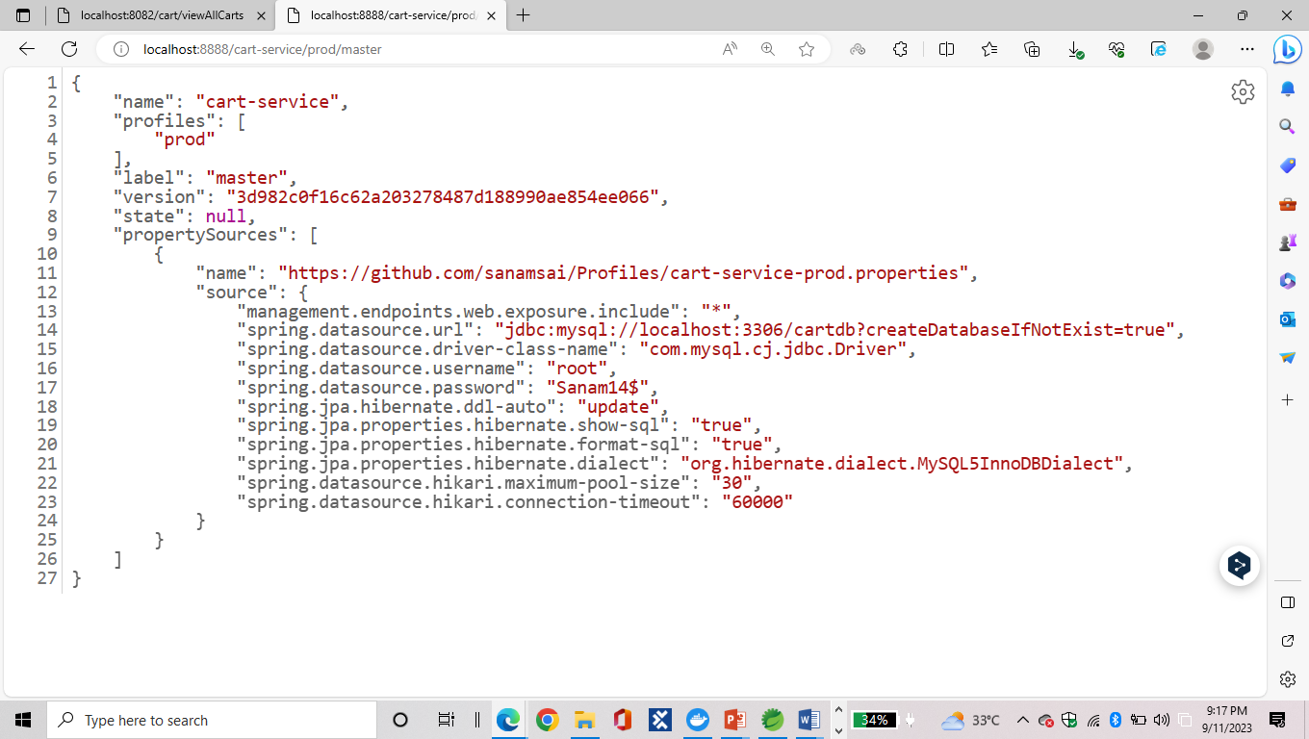
PROD PROFILE FOR CART SERVICE:
CONFIG SERVER:

Slide 30
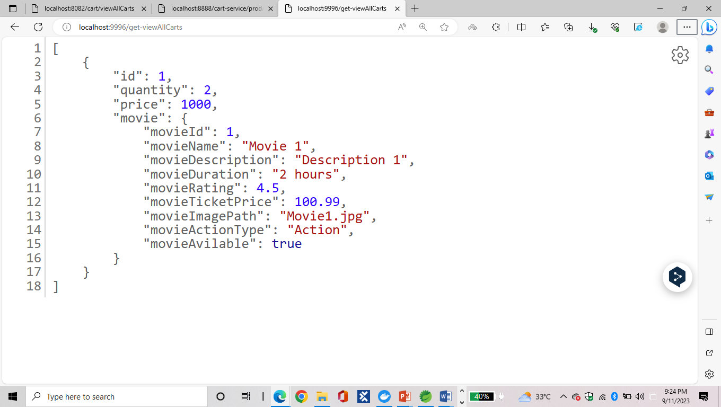
FEIGN FOR CART SERVICE:

Slide 31
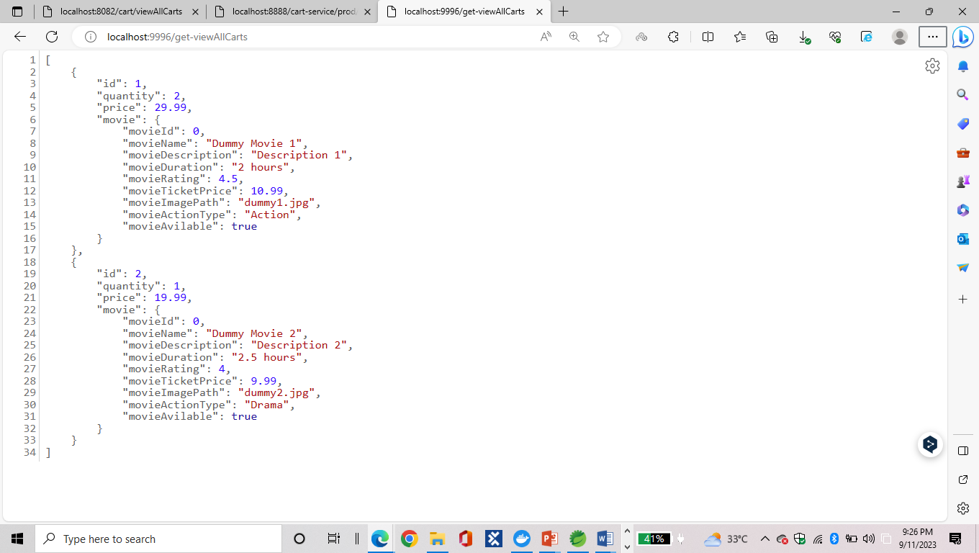
RESILIENCE FOR CART SERVICE:

Slide 32
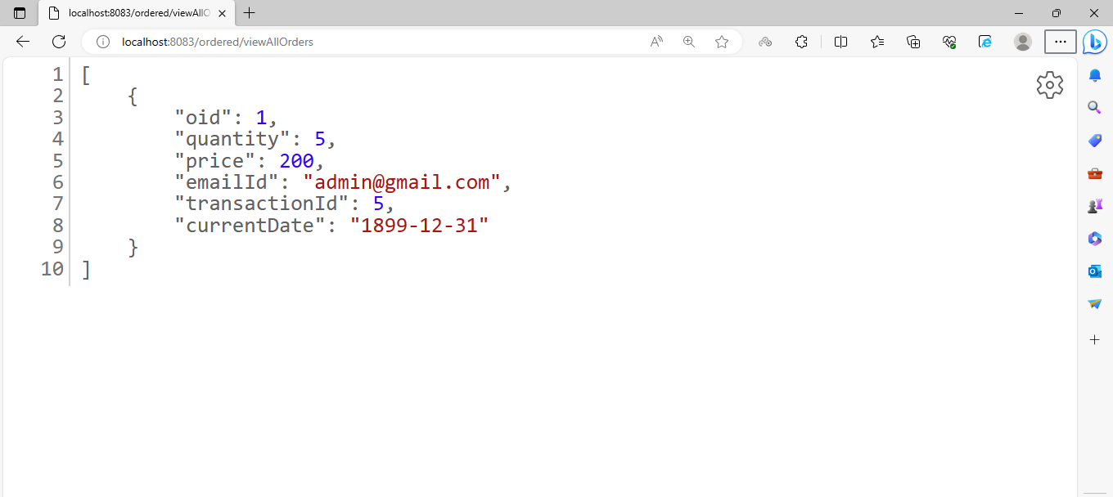
ORDERED SERVICE – MAIN APPLICATION:

Slide 33
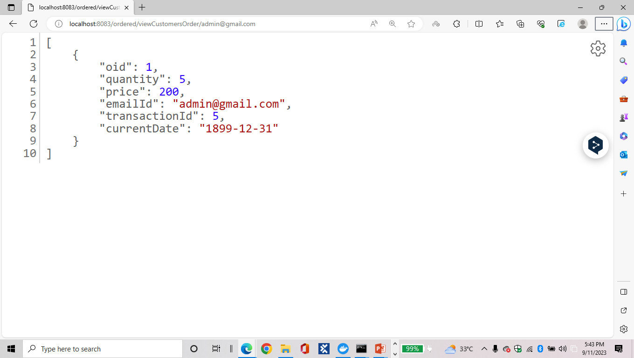

Slide 34
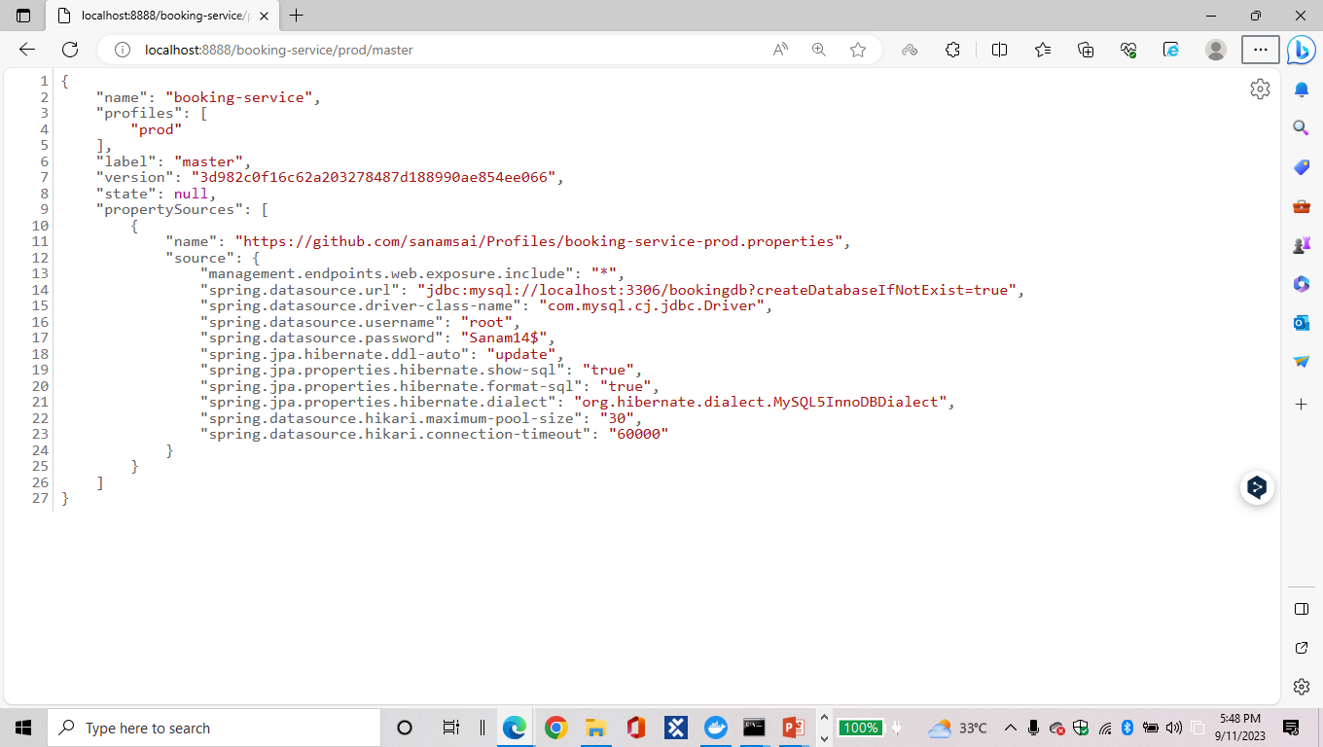
PROD PROFILE FOR ORDERED SERVICE:
CONFIG SERVER:

Slide 35
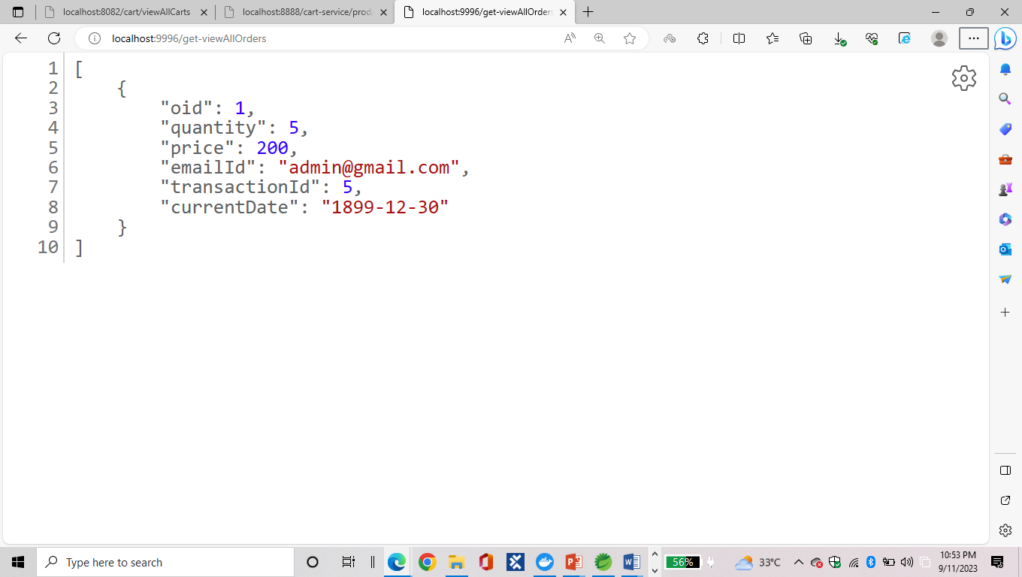
FEIGN FOR ORDERED SERVICE:

Slide 36
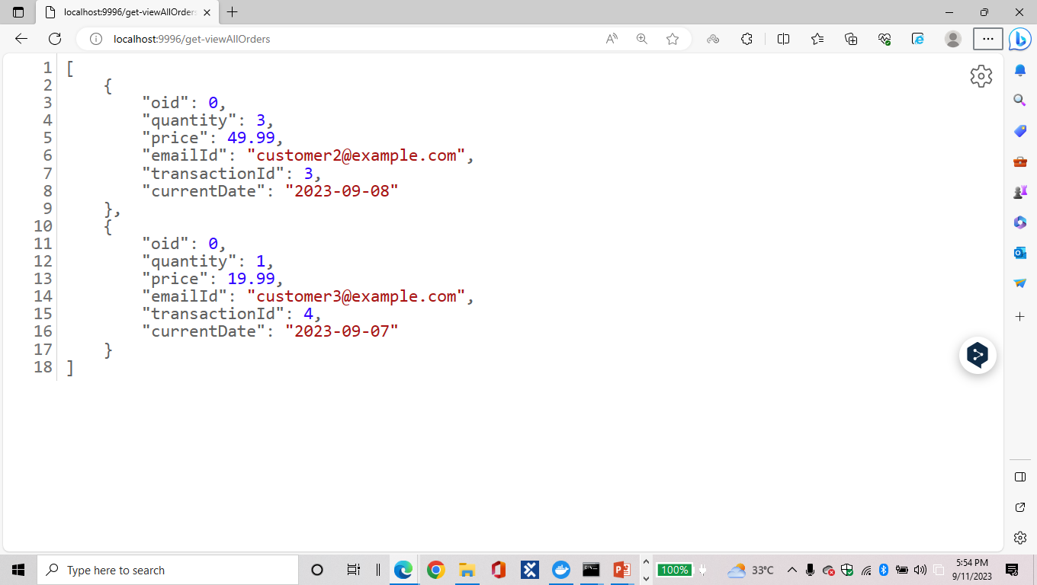
RESILIENCE FOR ORDERED SERVICE:

Slide 37
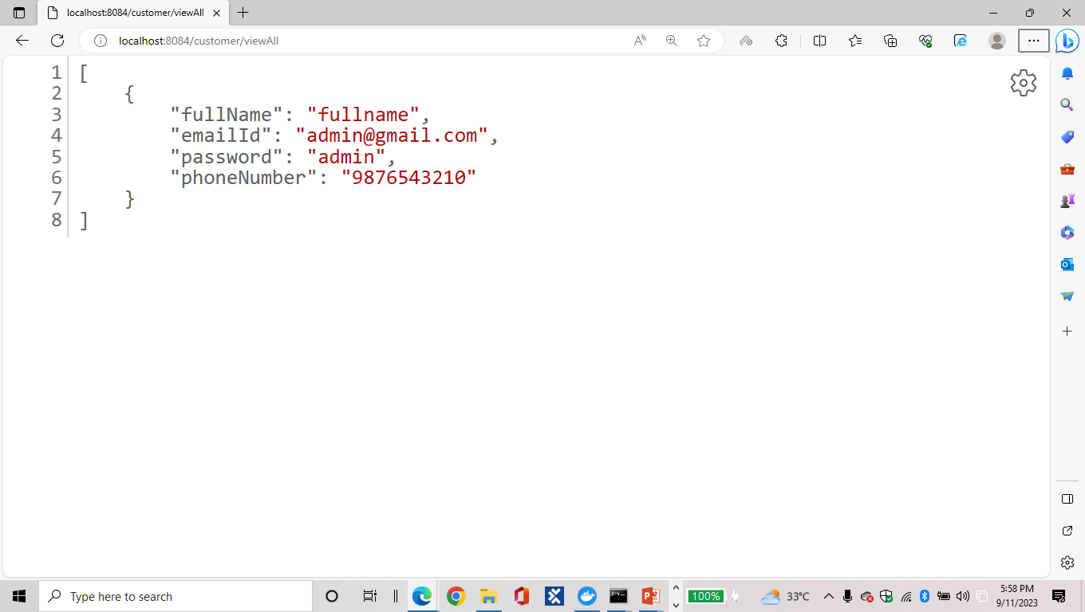
CUSTOMER SERVICE – MAIN APPLICATION:

Slide 38
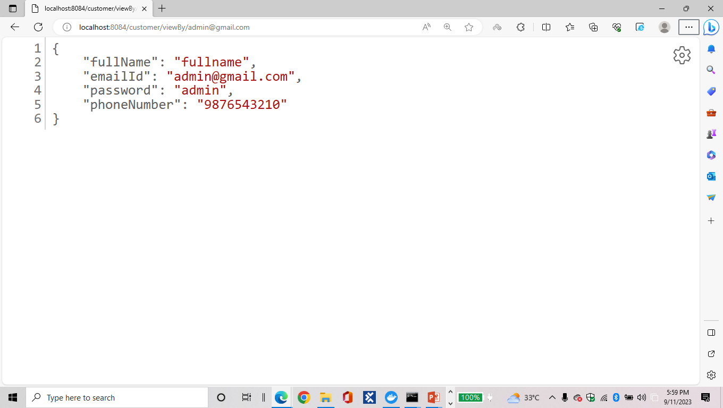

Slide 39
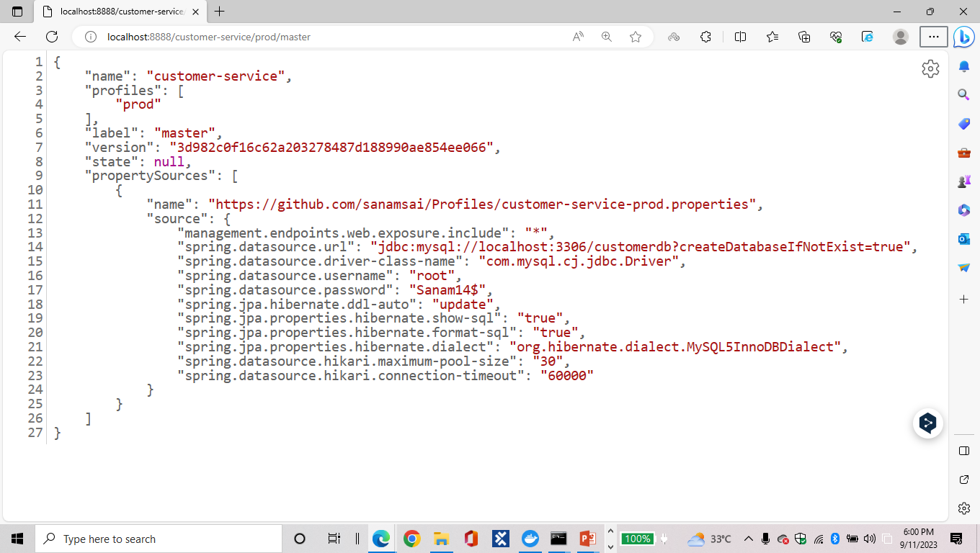
PROD PROFILE FOR CUSTOMER SERVICE:
CONFIG SERVER:

Slide 40
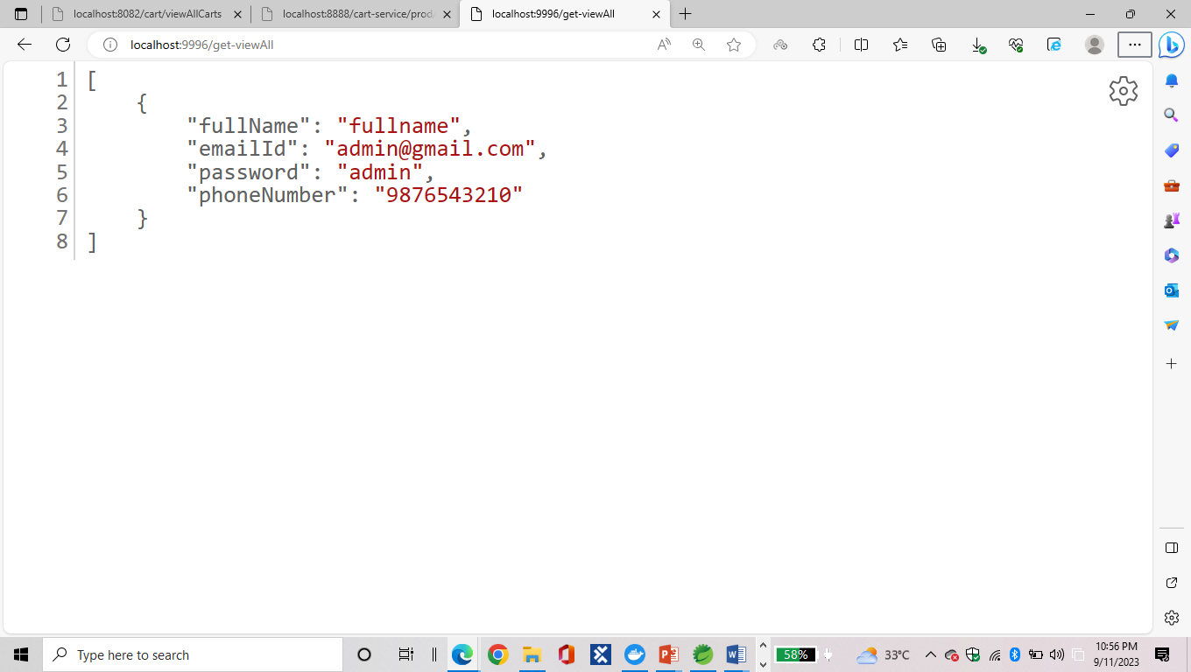
FEIGN FOR CUSTOMER SERVICE:

Slide 41
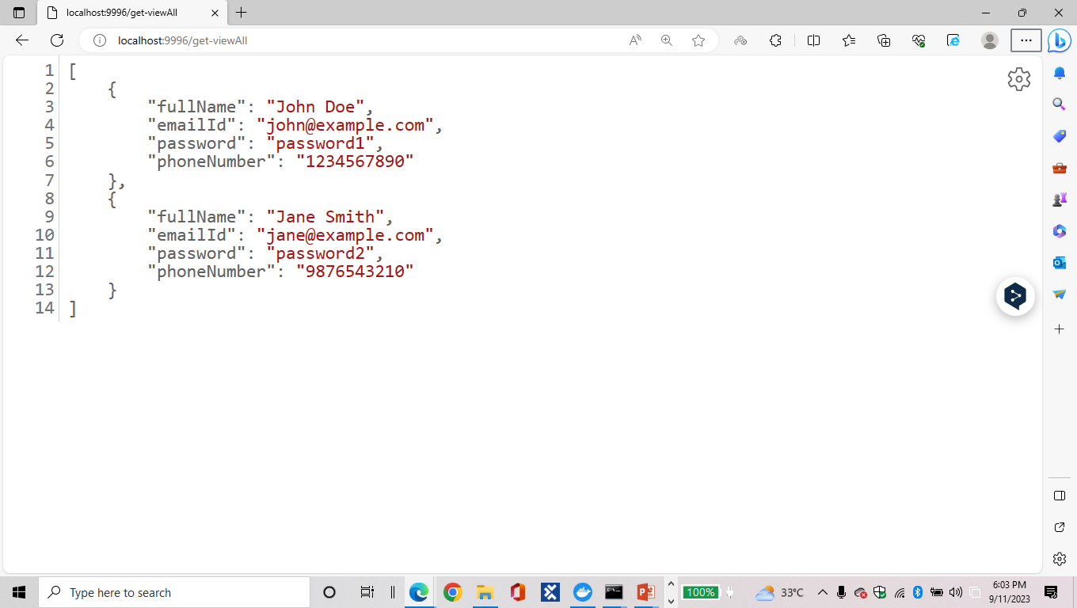
RESILIENCE FOR CUSTOMER SERVICE:

Slide 42
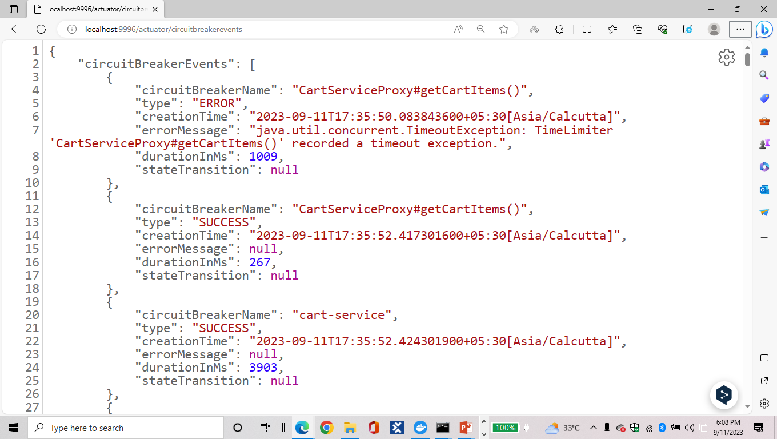
CIRCUIT BREAKER EVENTS:

Slide 43
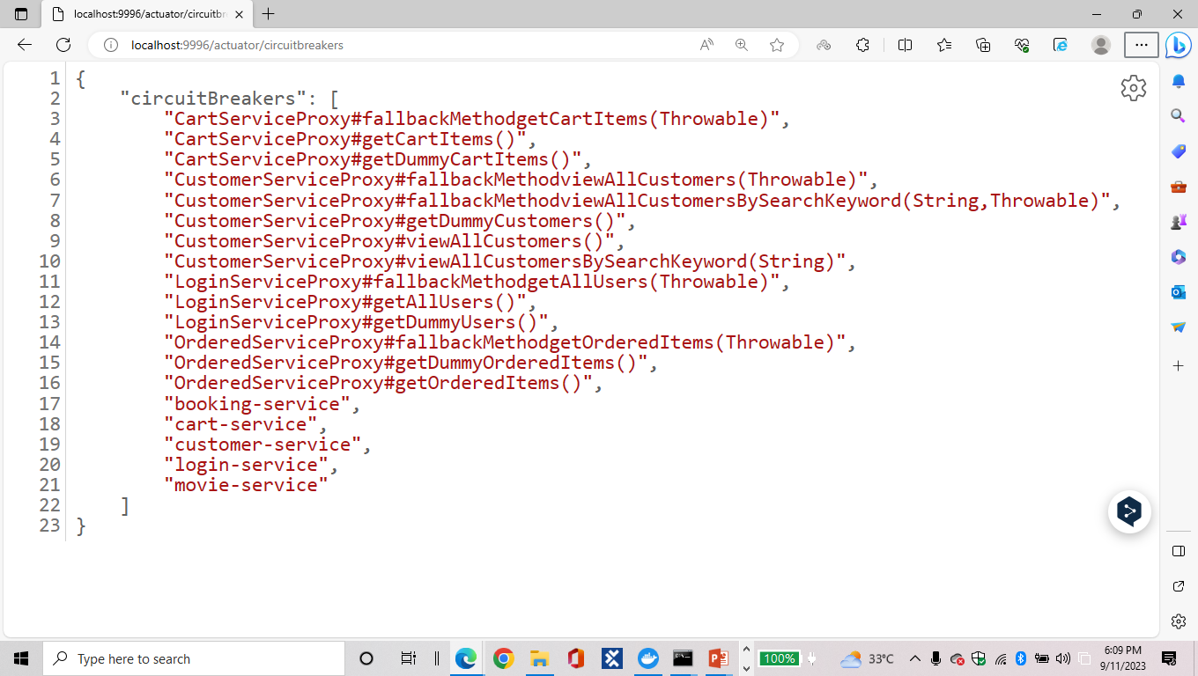
CIRCUIT BREAKERS:

Slide 44
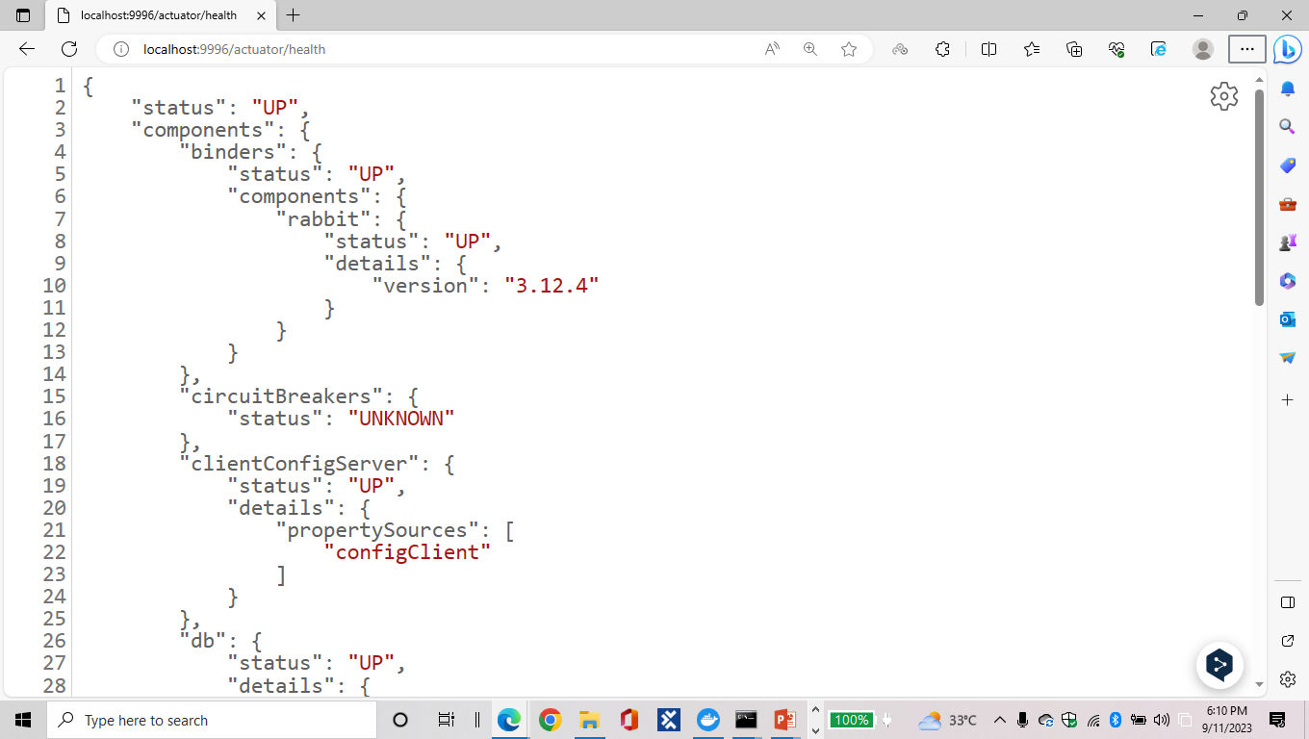
ACTUATOR:

Slide 45
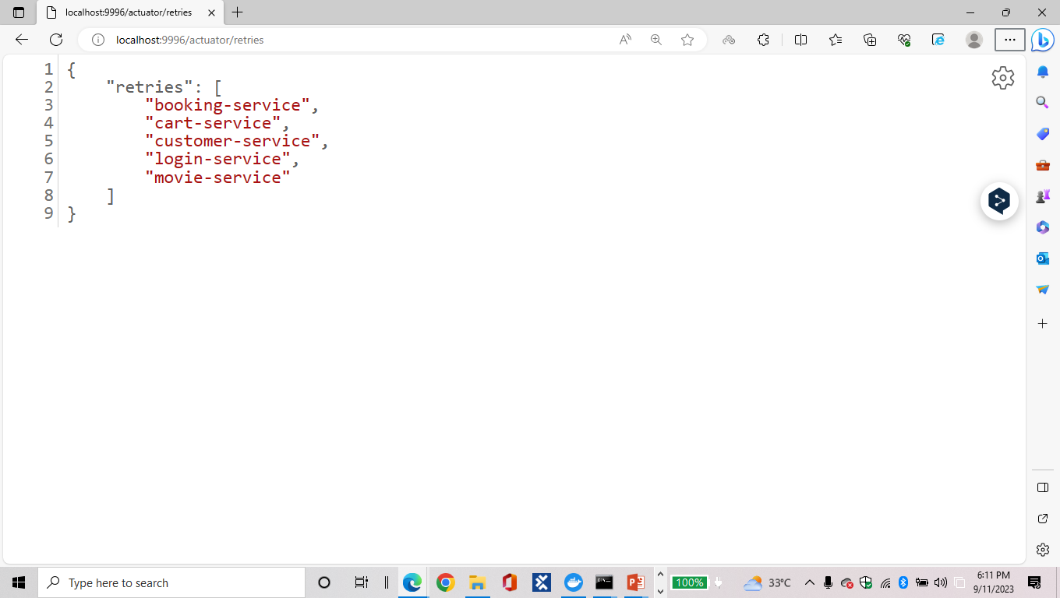
RETRIES:

Slide 46
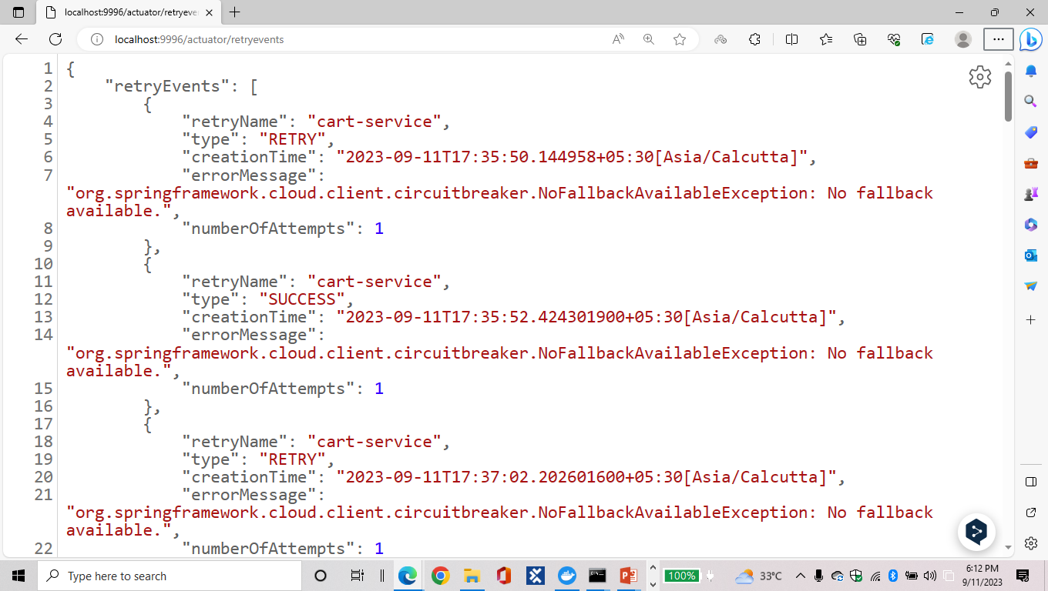
RETRY EVENTS:

Slide 47
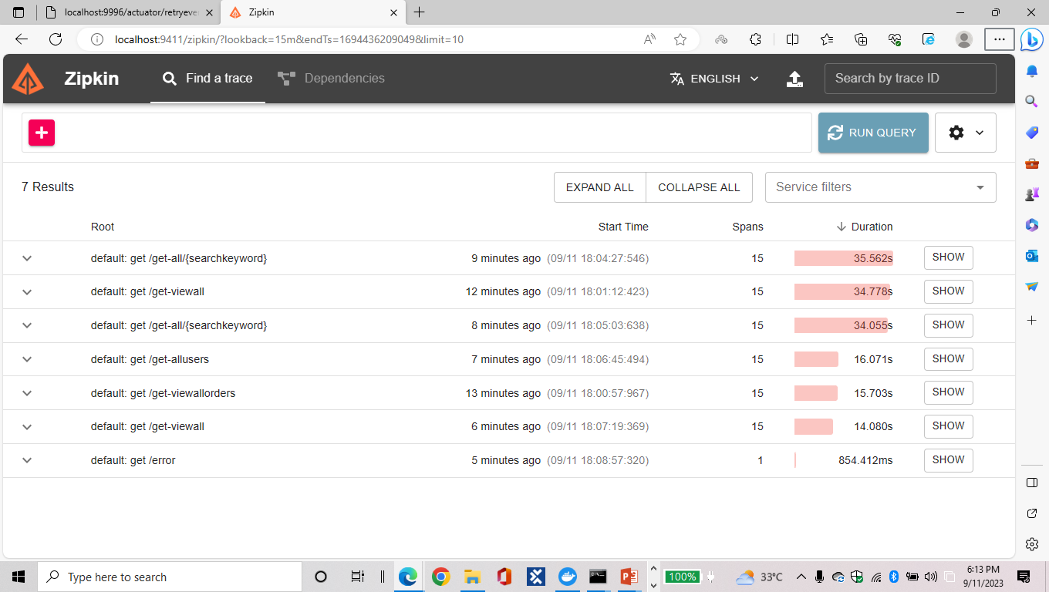
ZIPKIN:

Slide 48
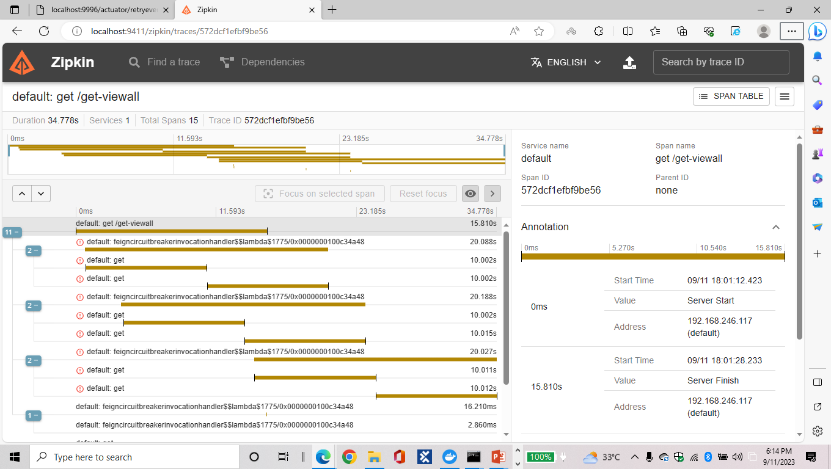

Slide 49
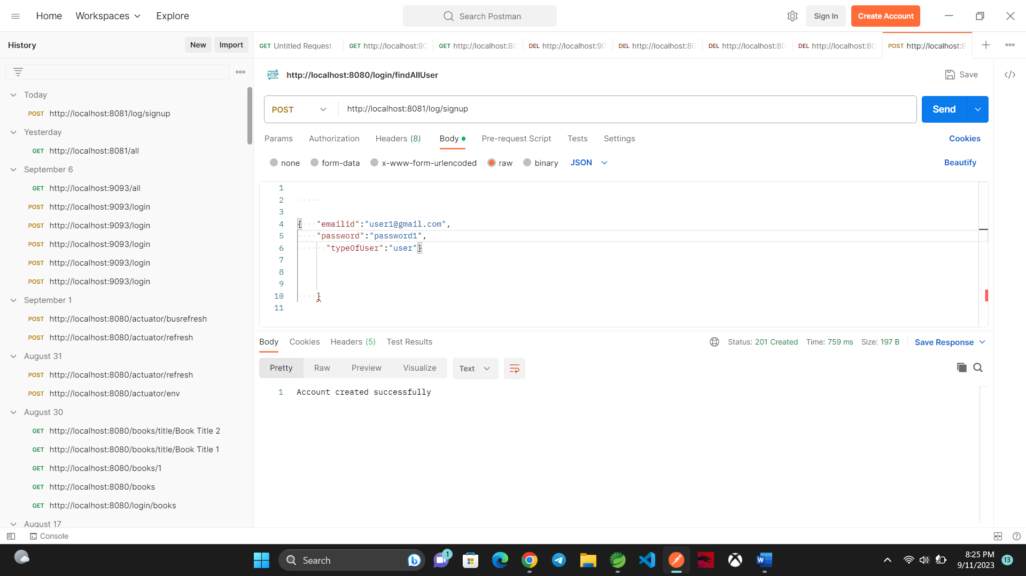
POSTMAN OUTPUTS:
LOGIN:

Slide 50
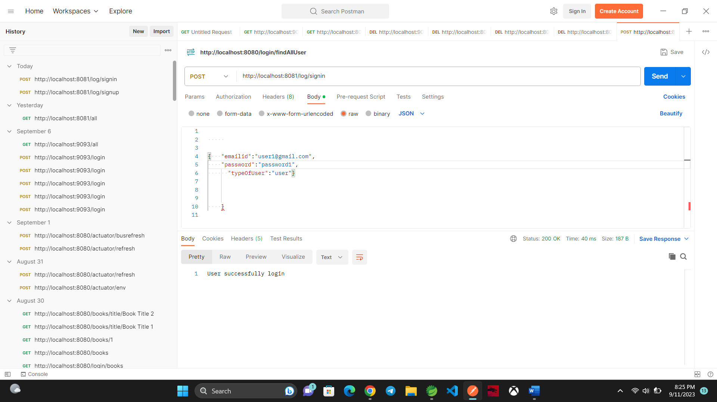

Slide 51
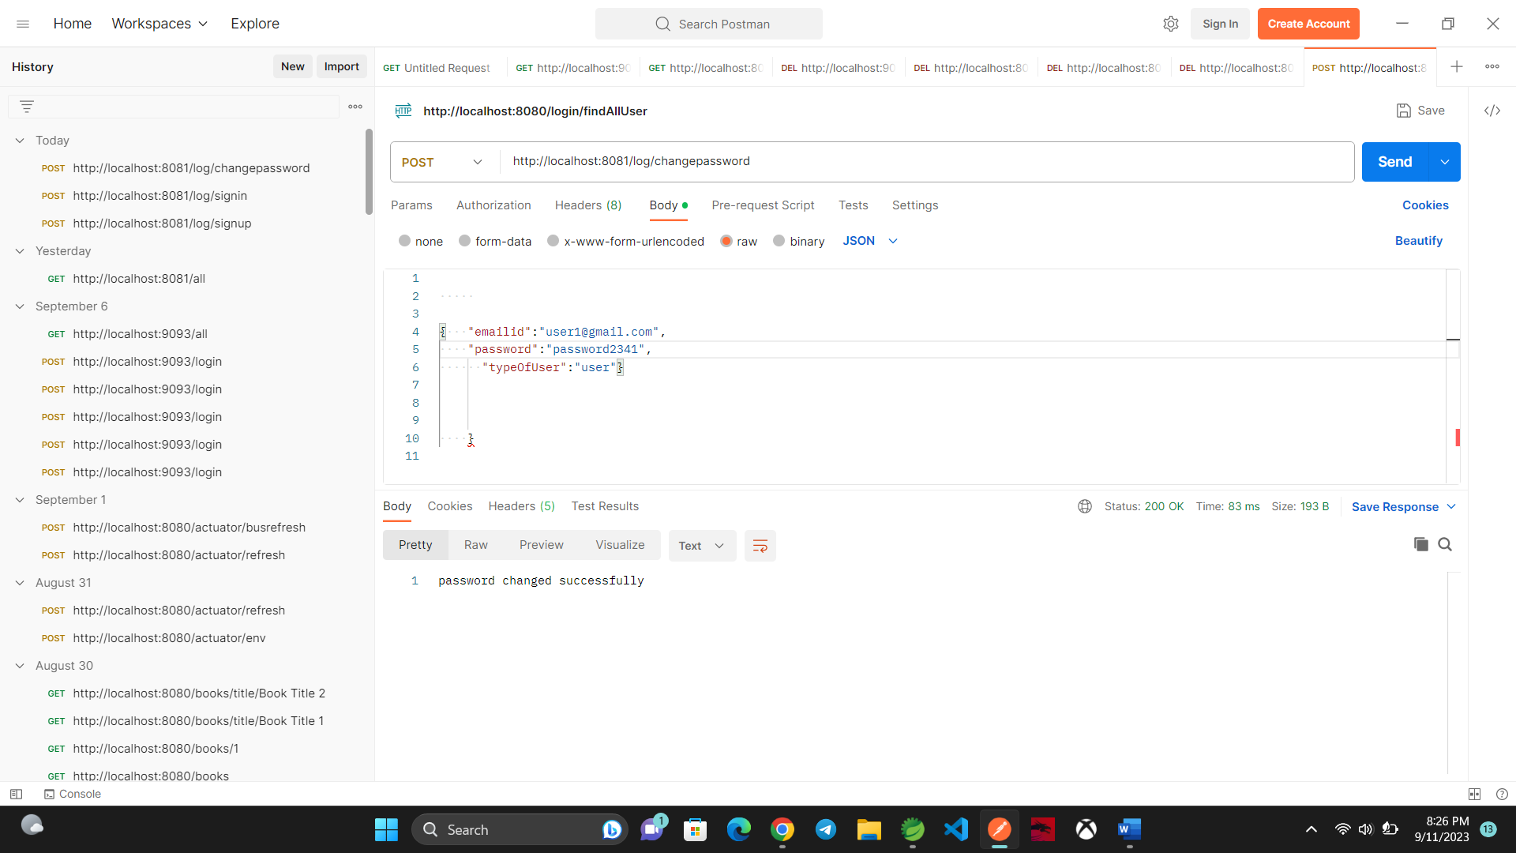

Slide 52
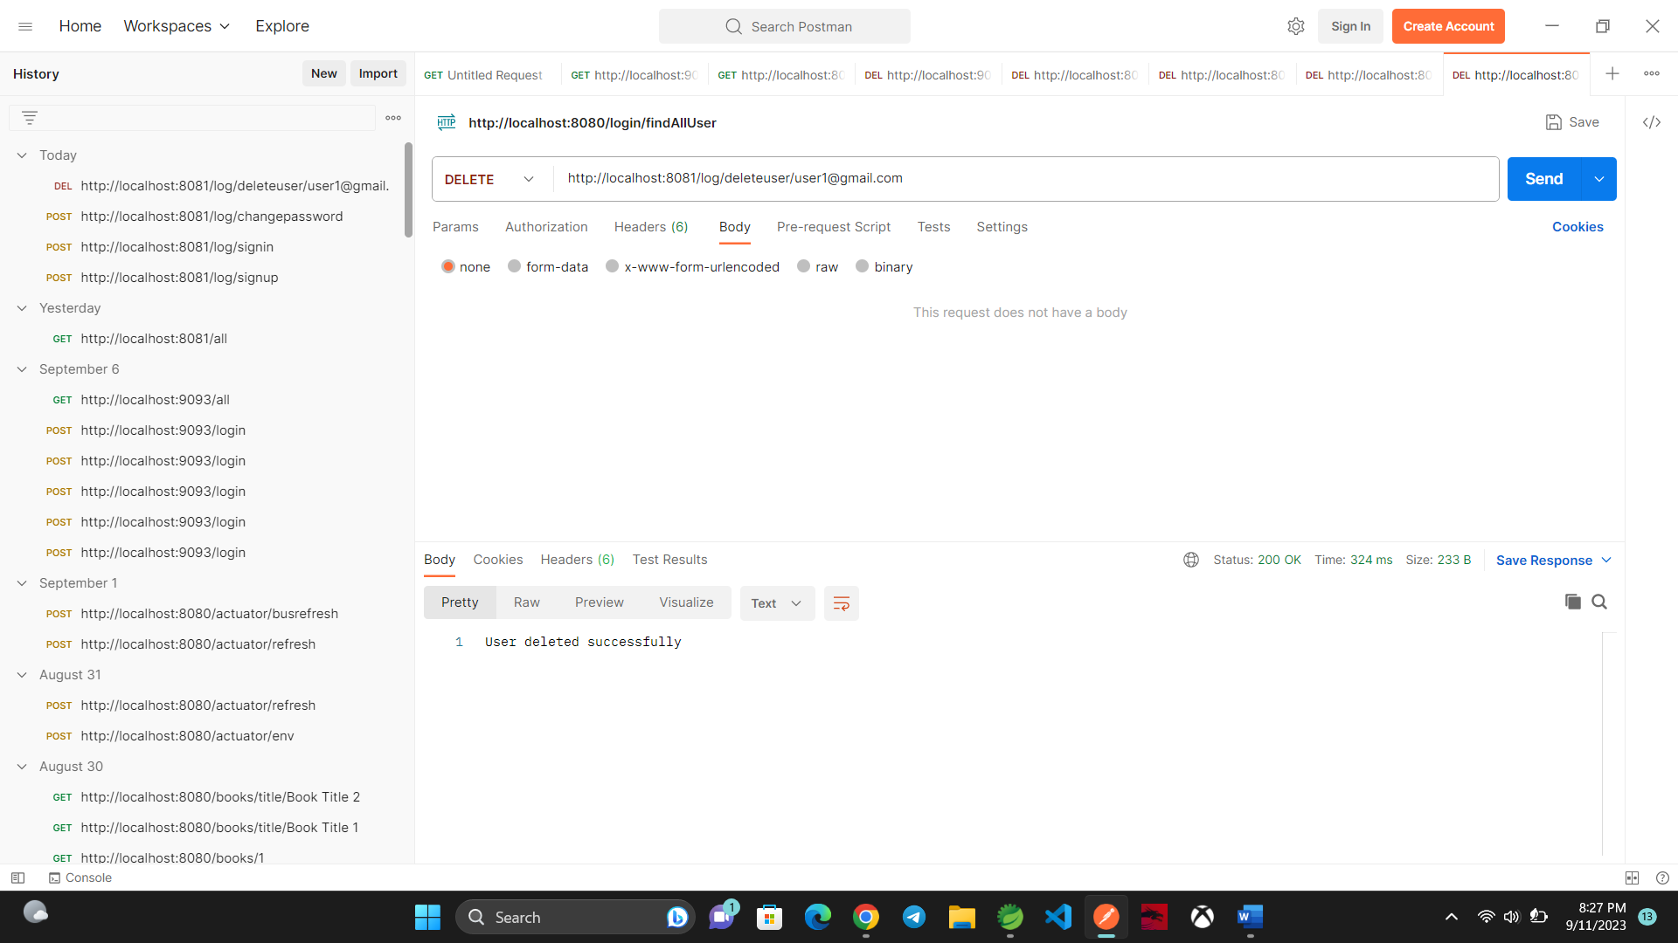

Slide 53
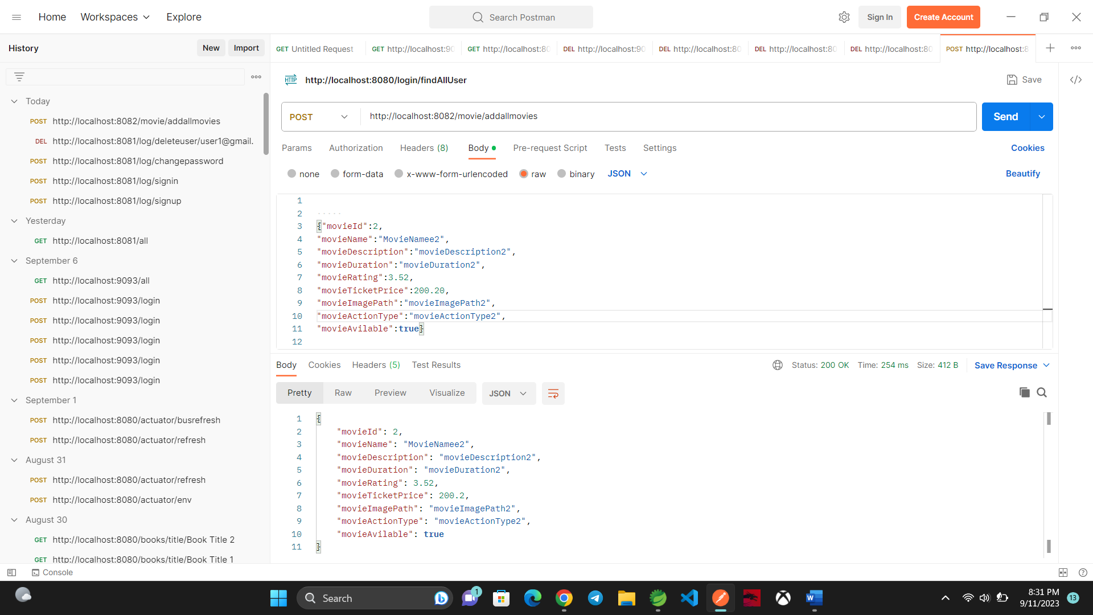
MOVIE:

Slide 54


Slide 55
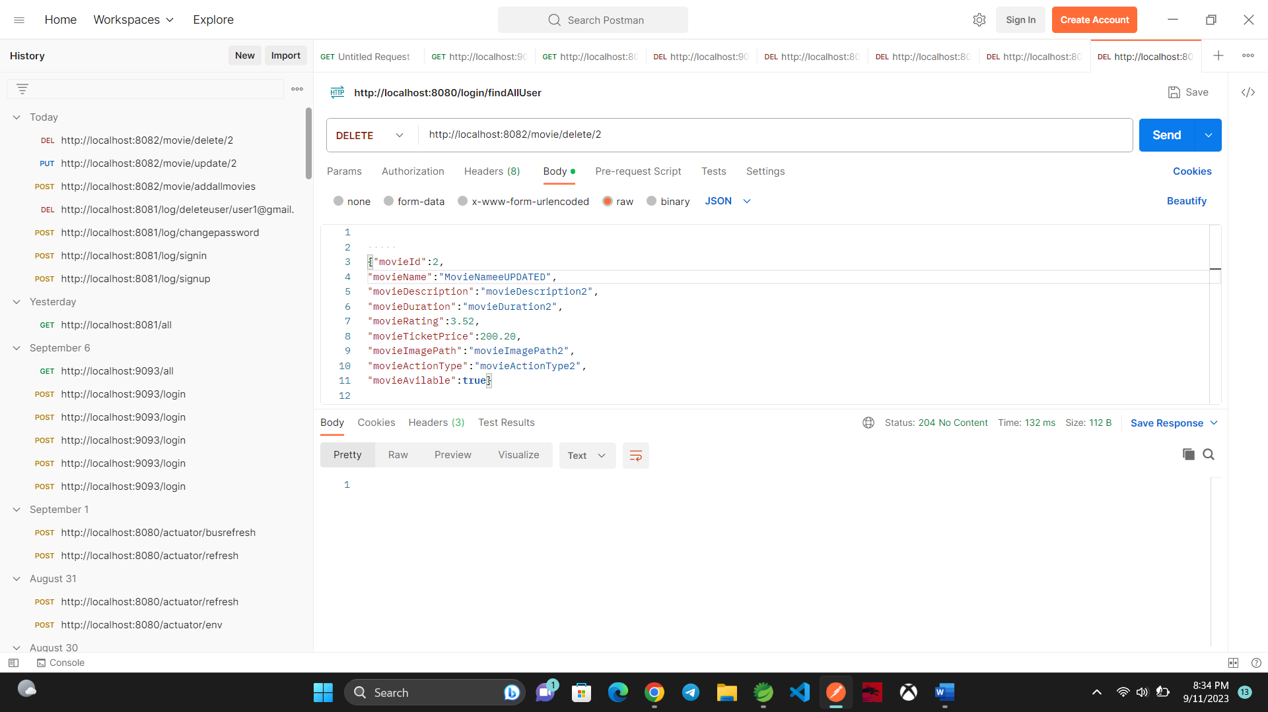

Slide 56
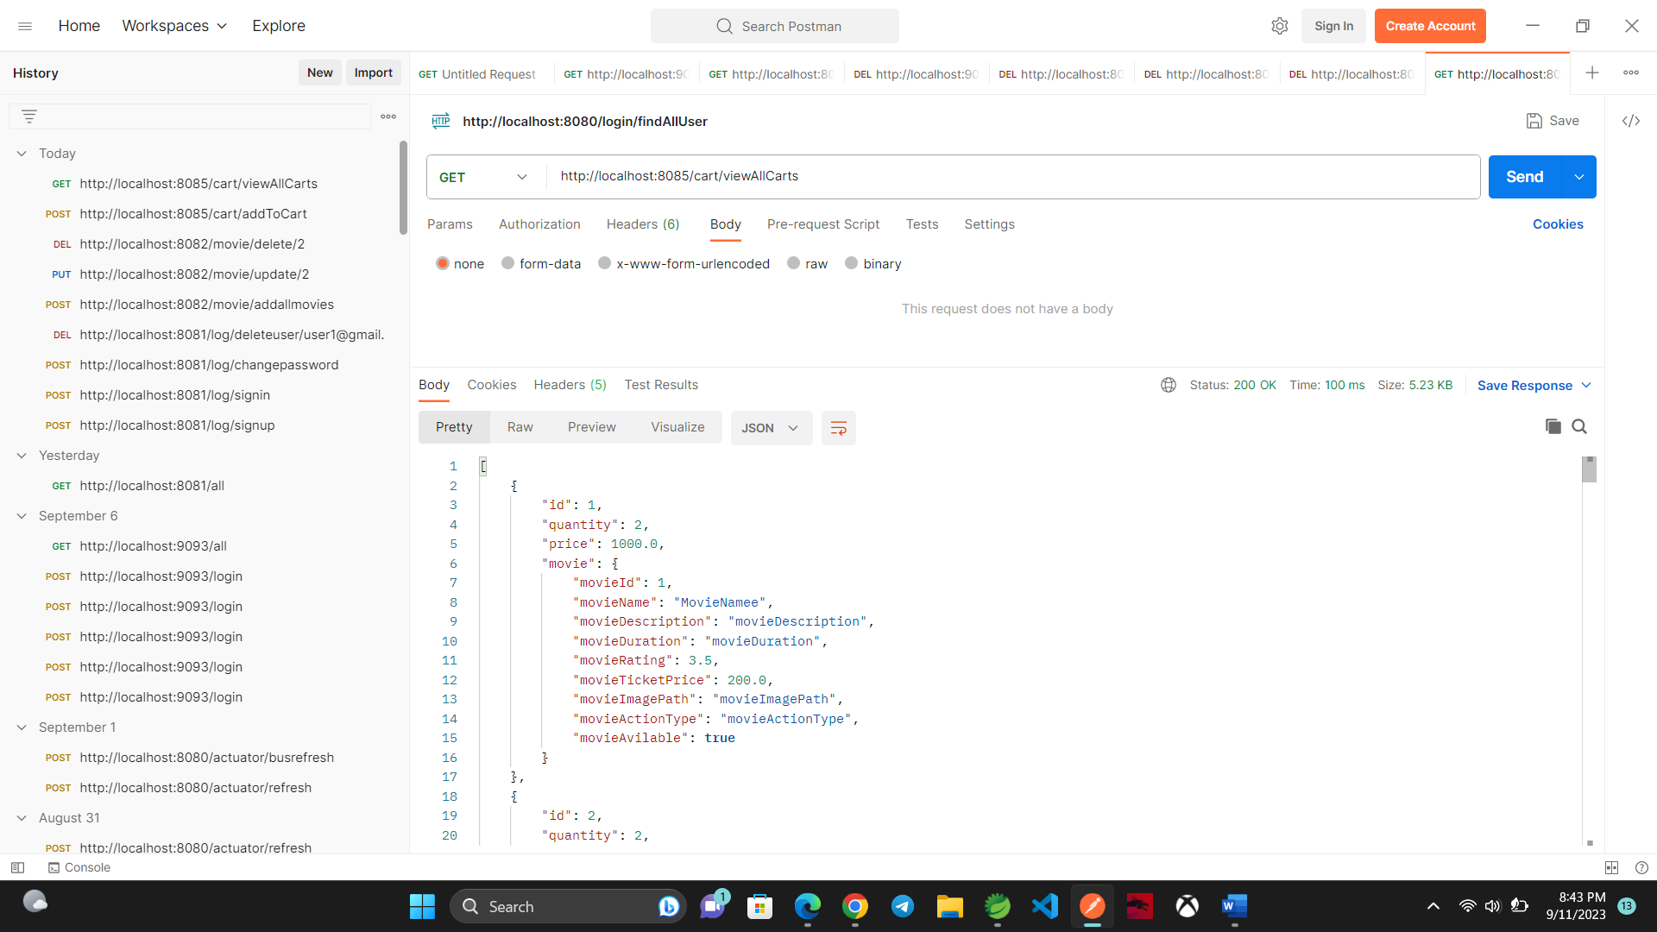
CART:

Slide 57
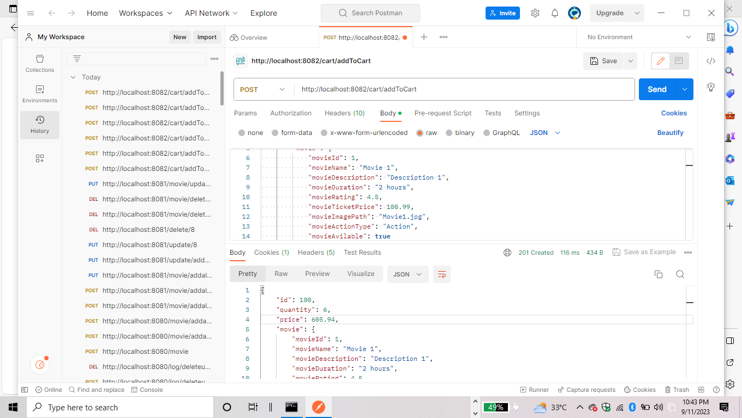

Slide 58
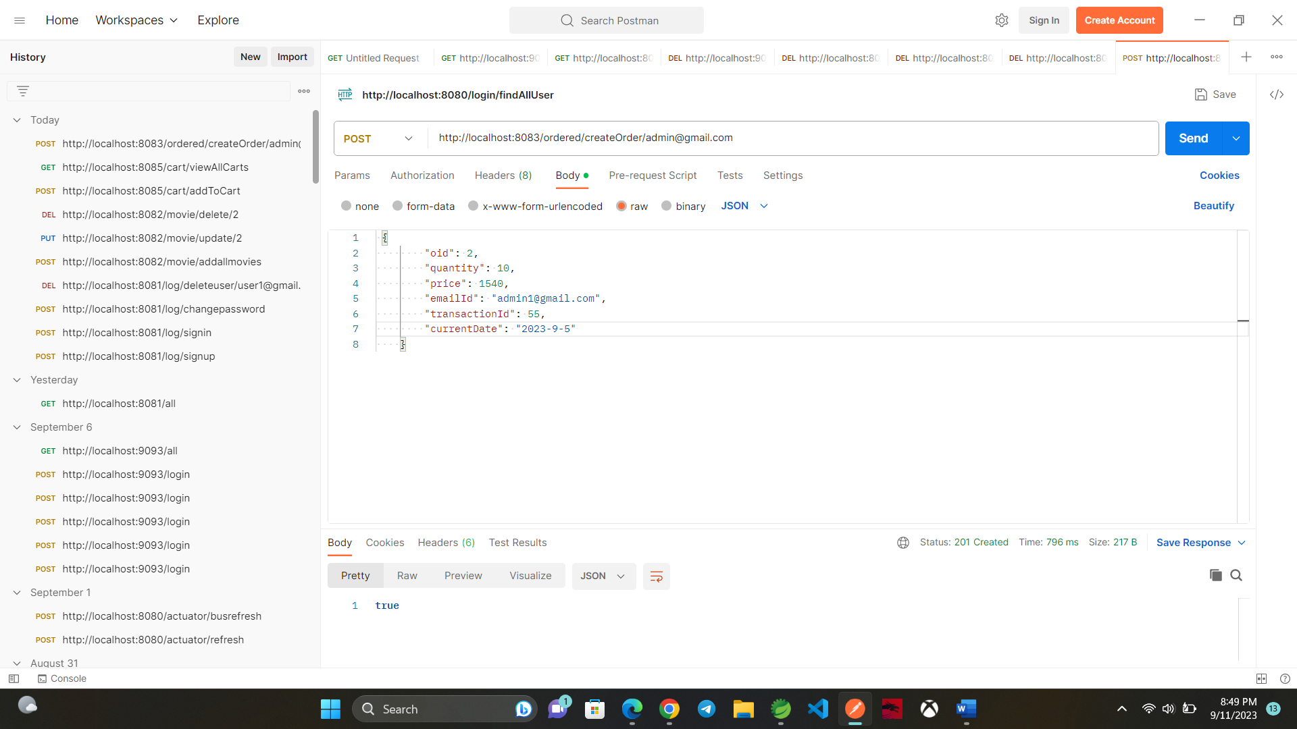
ORDERED:

Slide 59
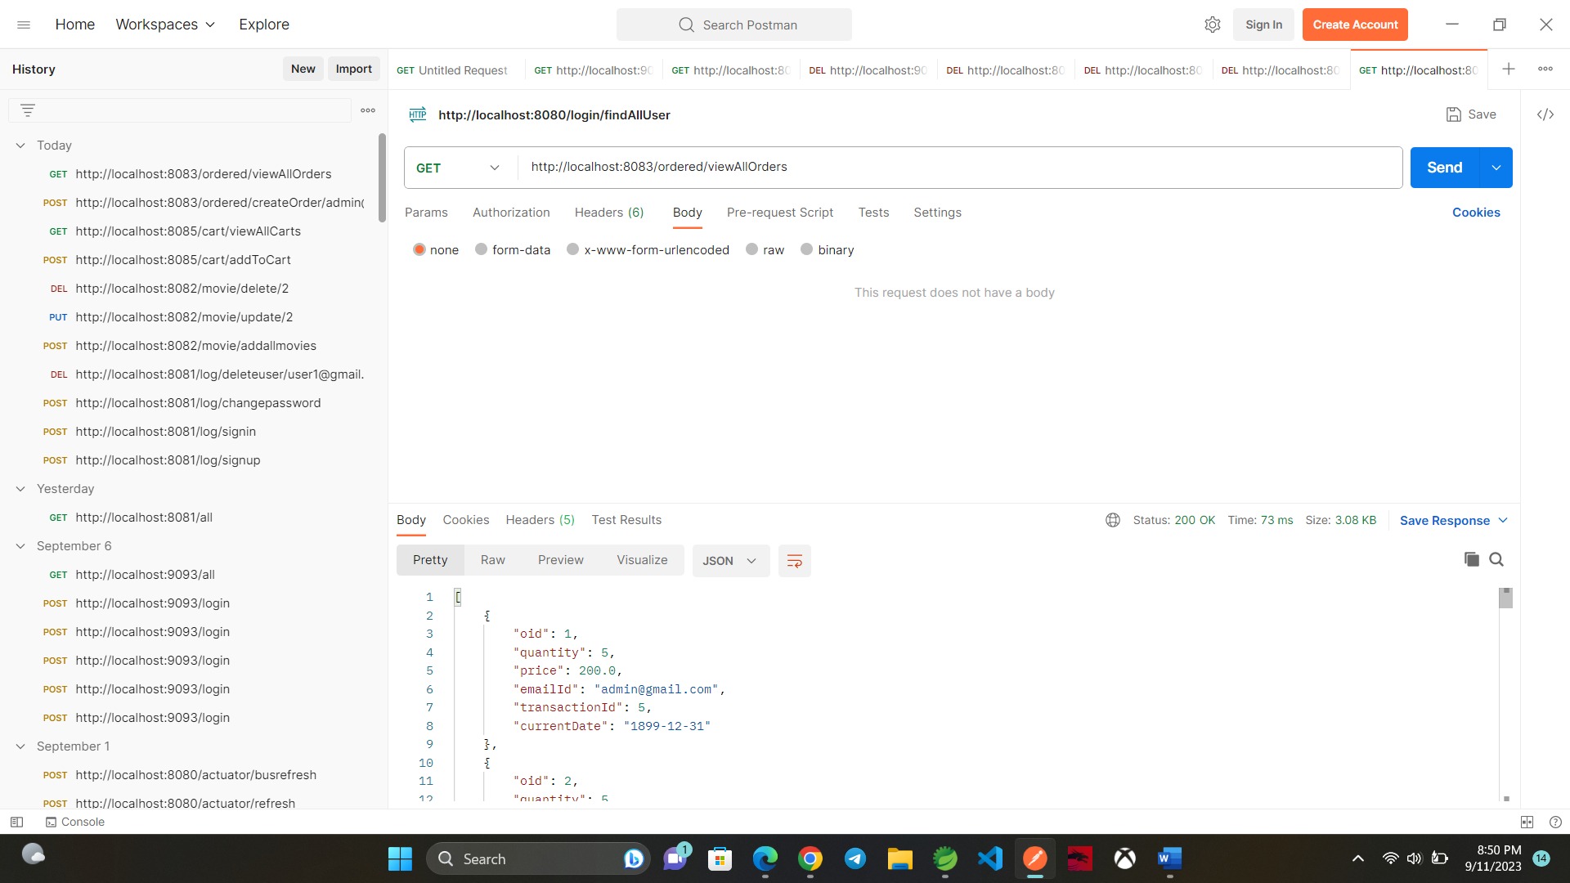

Slide 60
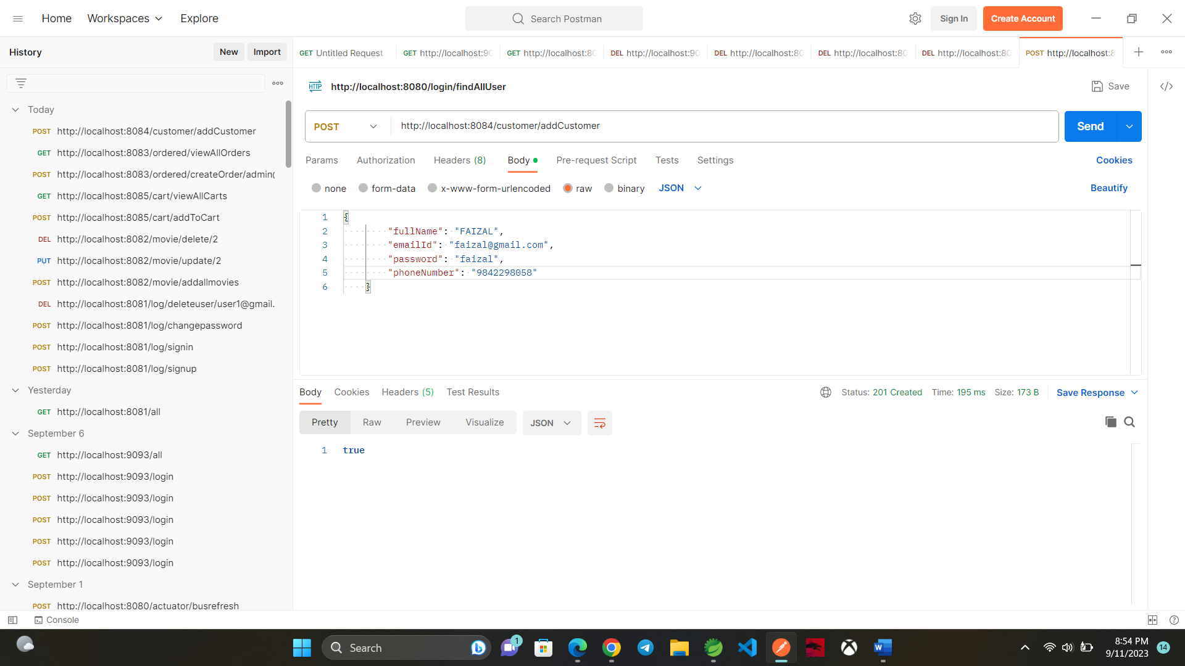
CUSTOMER:

Slide 61
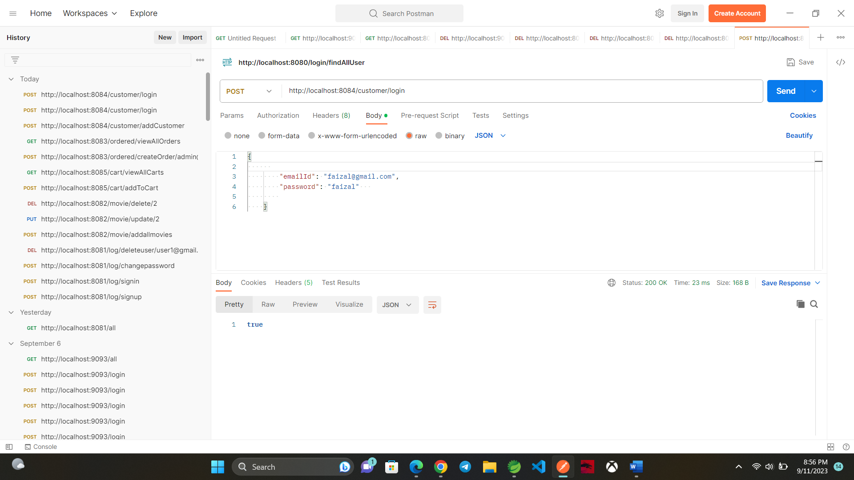

Slide 62
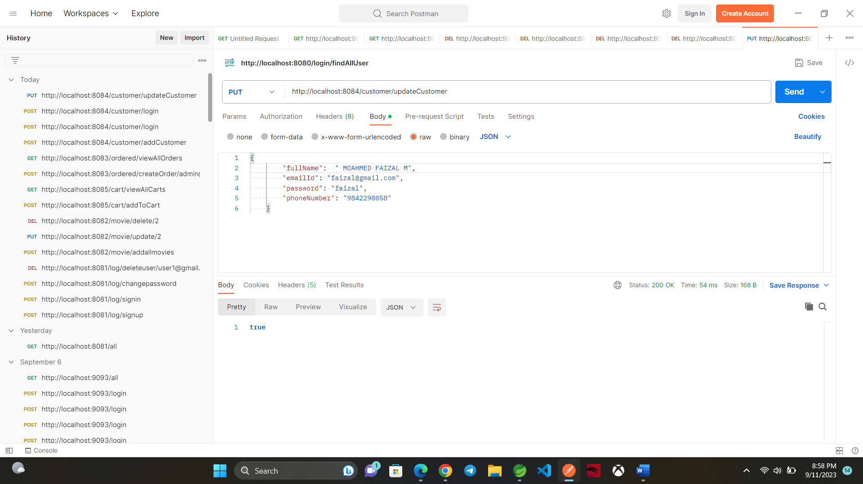

Slide 63
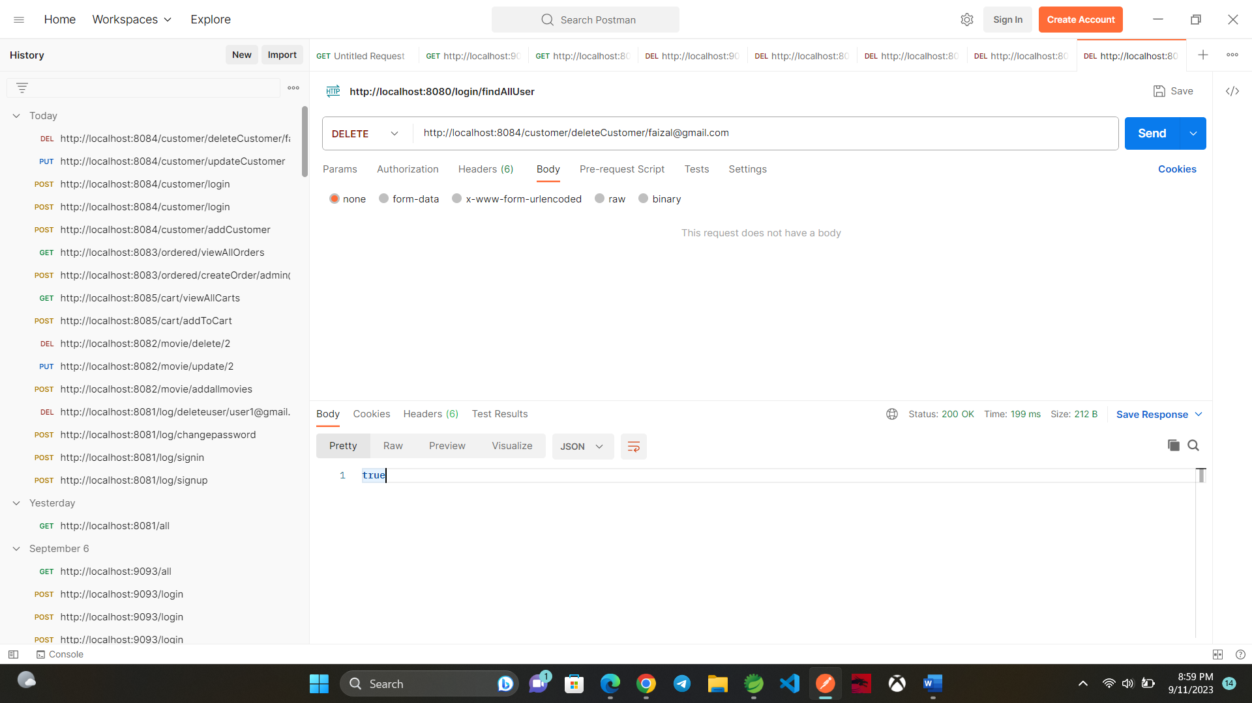

Slide 64
THANK YOU!

